Slide 1
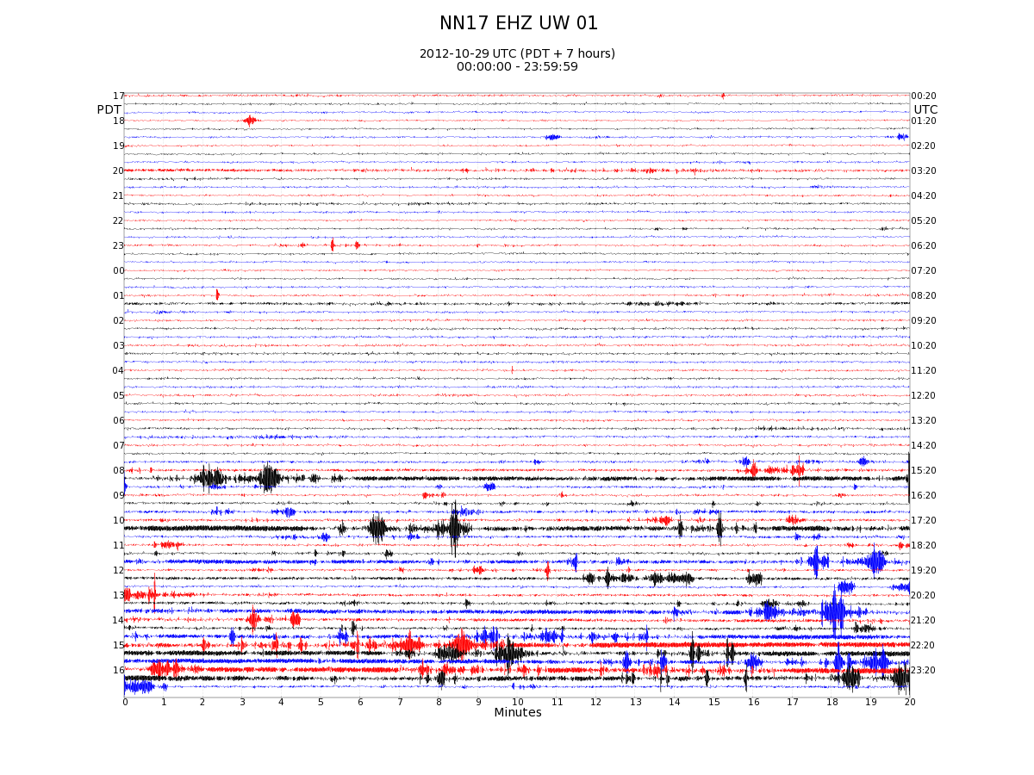
Located Event
Possible Event
Quarry Noise

Slide 2
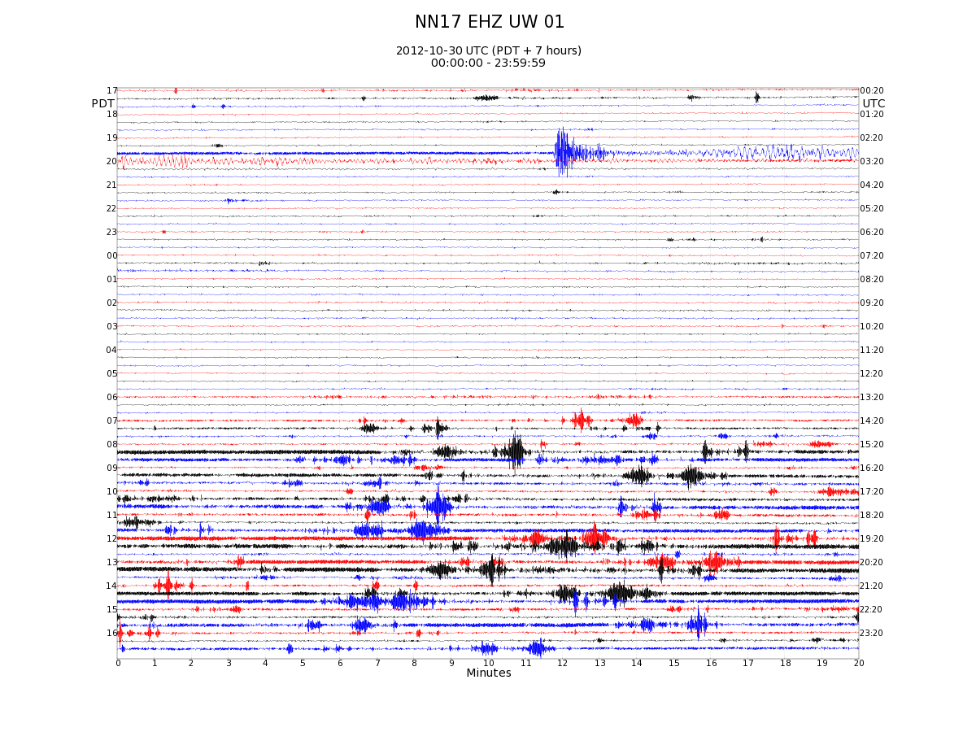
Located Event
Possible Event
Quarry Noise

Slide 3
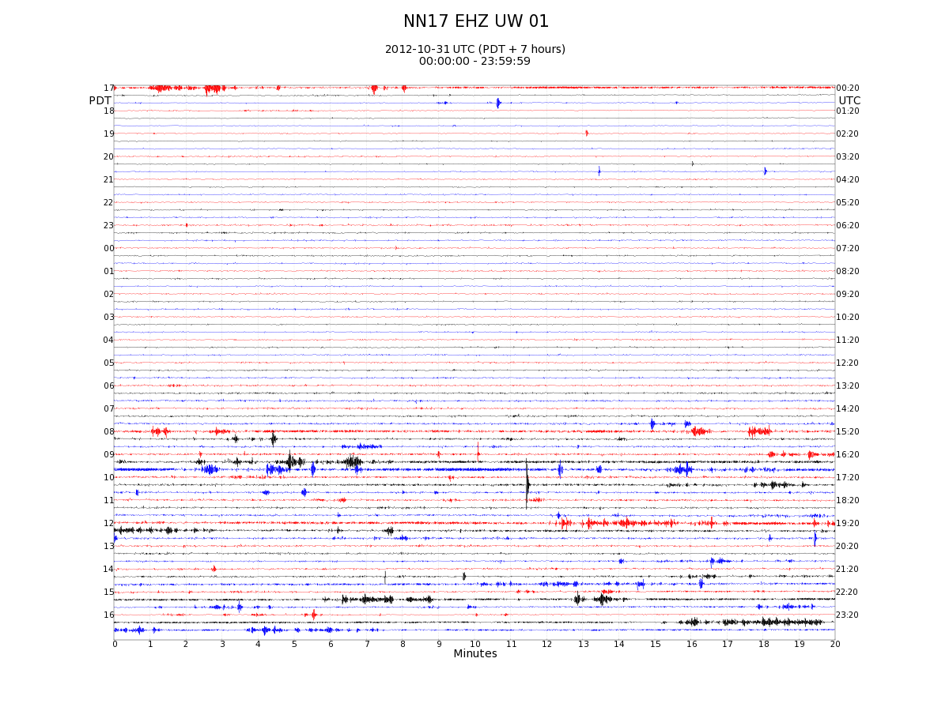
Located Event
Possible Event
Quarry Noise

Slide 4
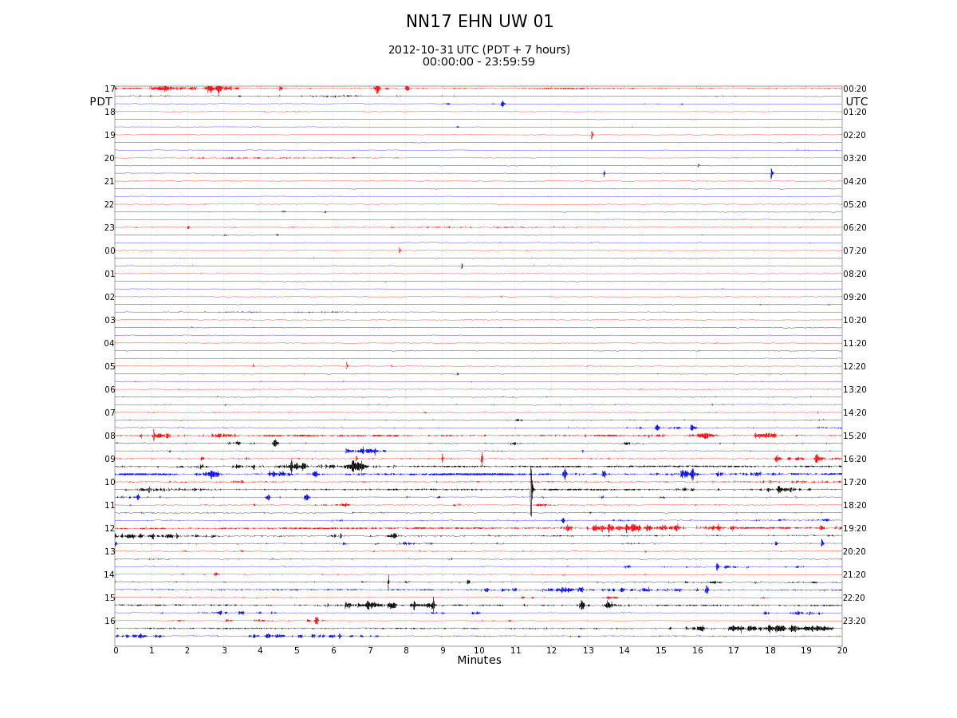
Located Event
Possible Event
Quarry Noise

Slide 5
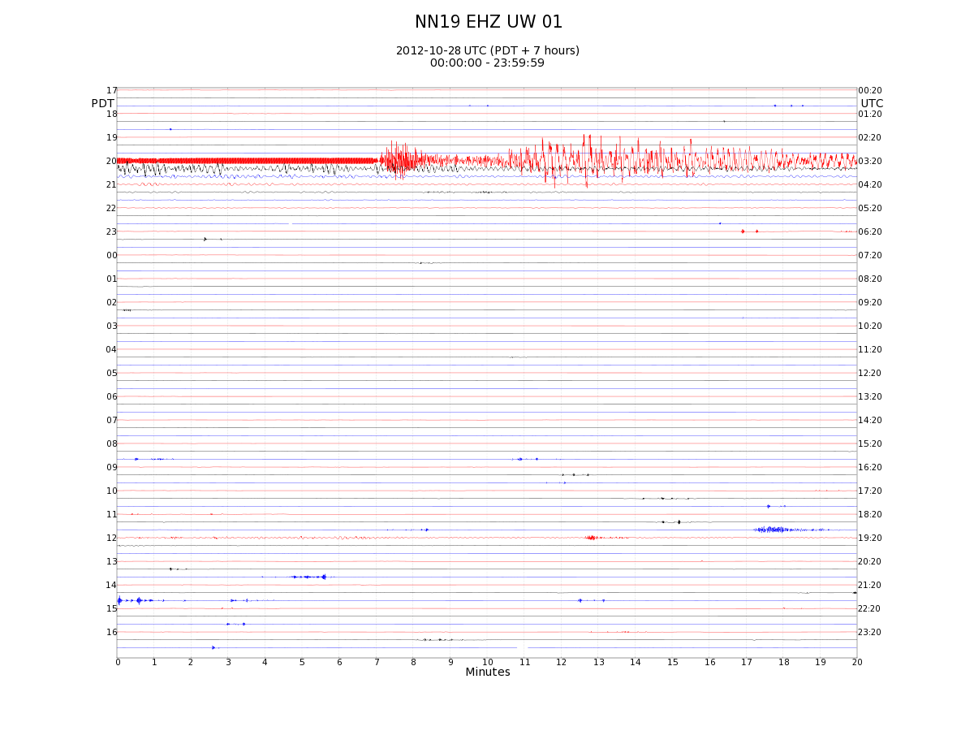
10/28/2012: NN19 Z M7.7 Queen Charlotte Island at 03:04 UTC

Slide 6
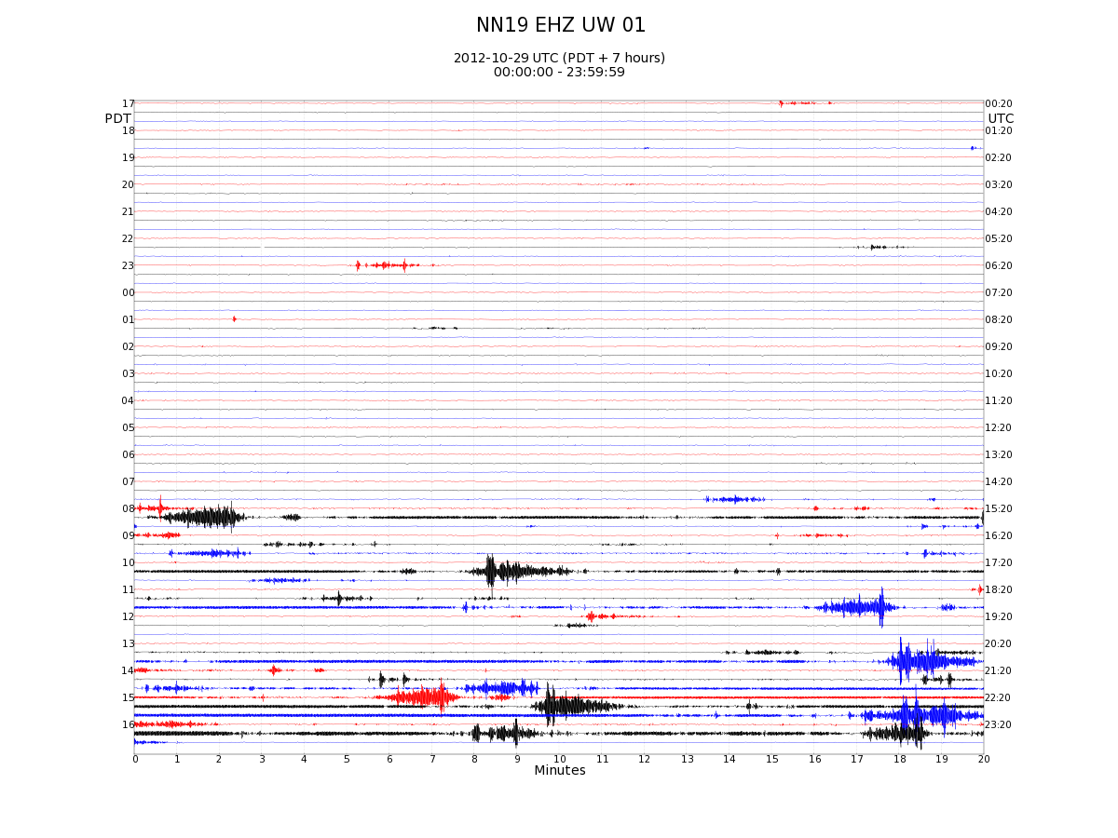
10/29/2012: NN19 Z
Quarry Noise

Slide 7
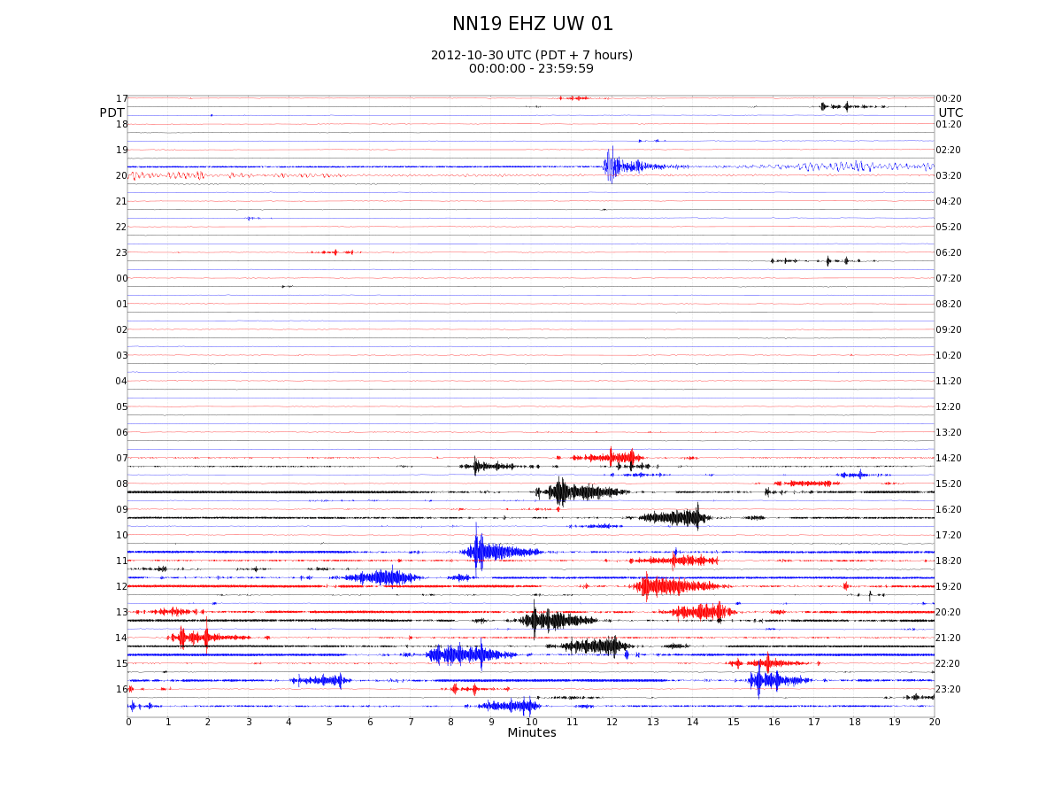
10/30/2012: NN19 Z

Slide 8
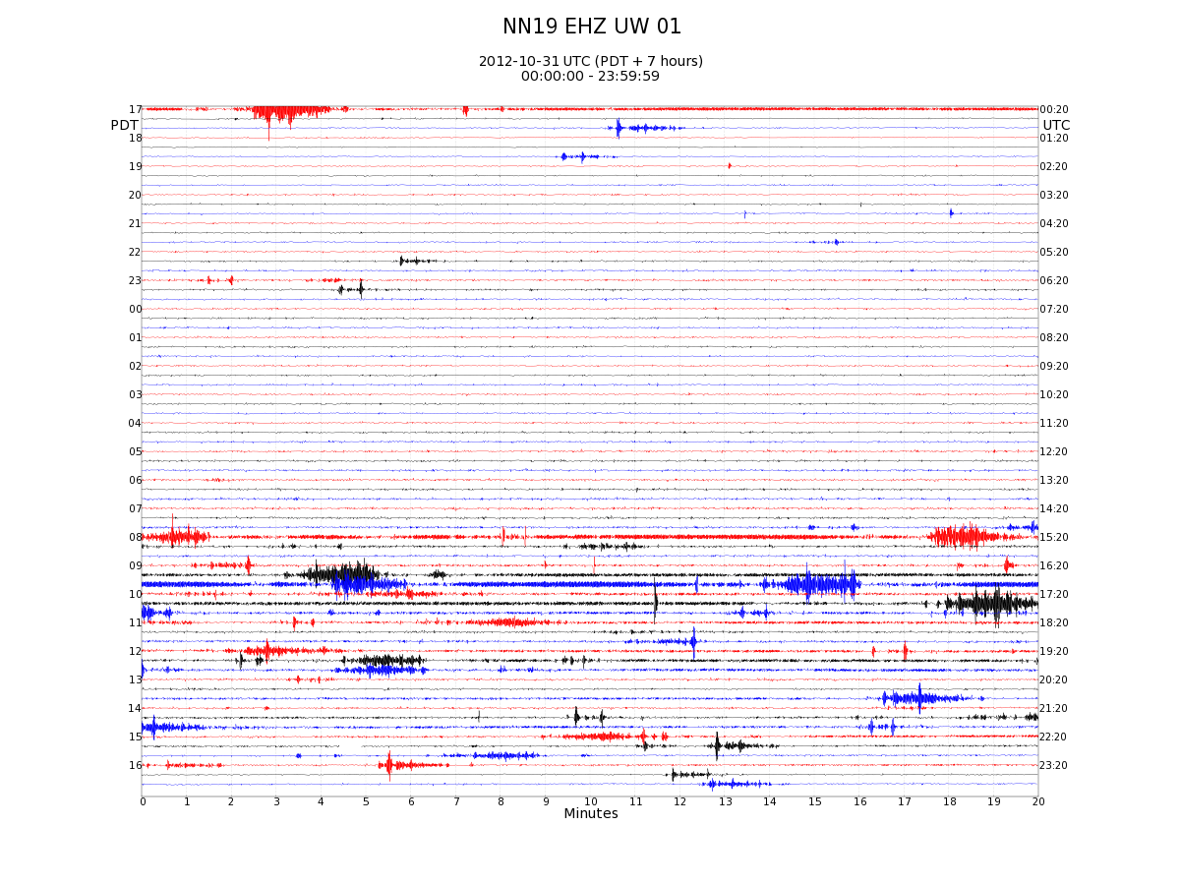
10/31/2012: NN19 Z
Located Event
Possible Event
Quarry Noise

Slide 9
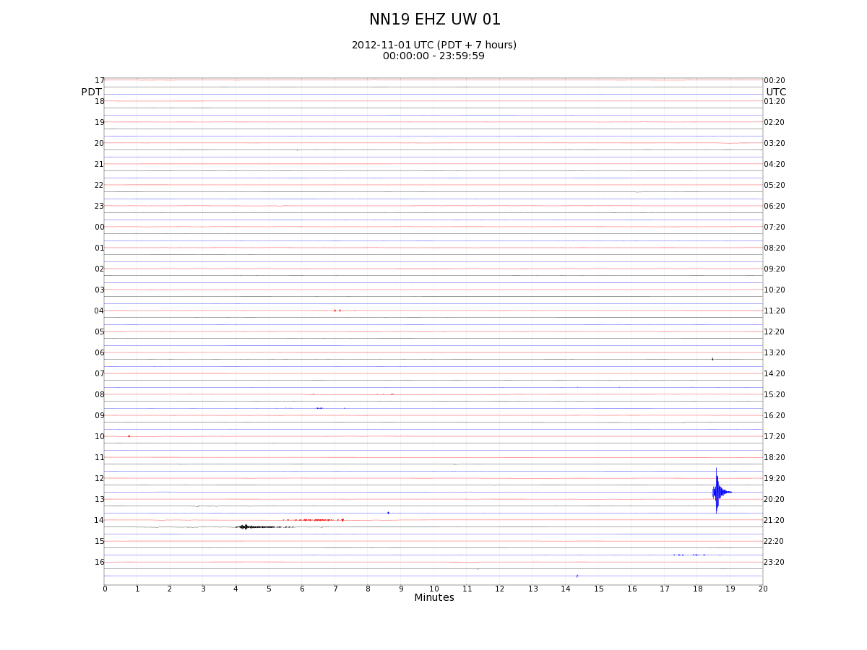
11/01/2012: NN19 Z

Slide 10
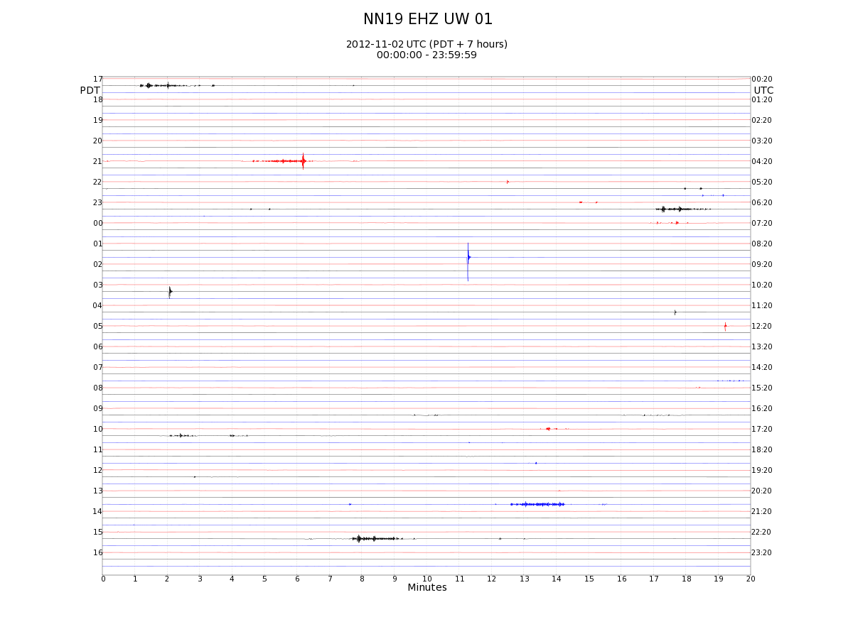
11/02/2012: NN19 Z

Slide 11
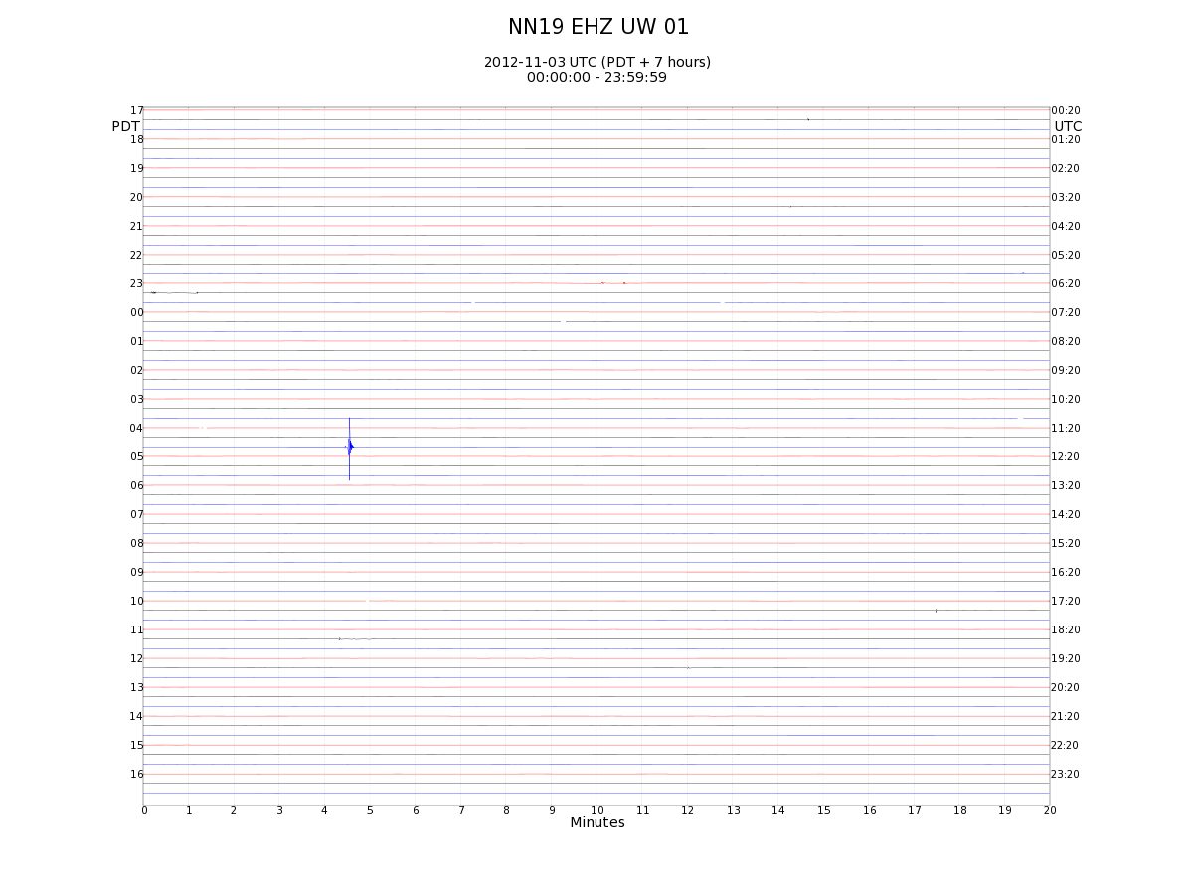
11/03/2012 (Sat): NN19 Z

Slide 12
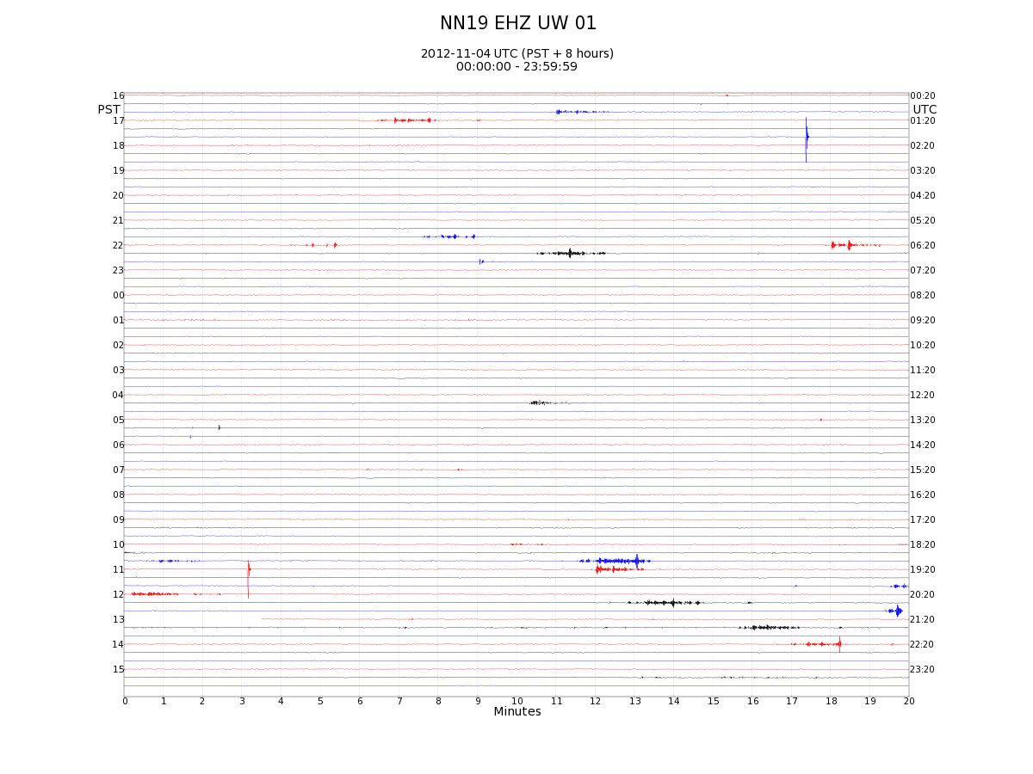
11/04/2012 (Sun): NN19 Z

Slide 13
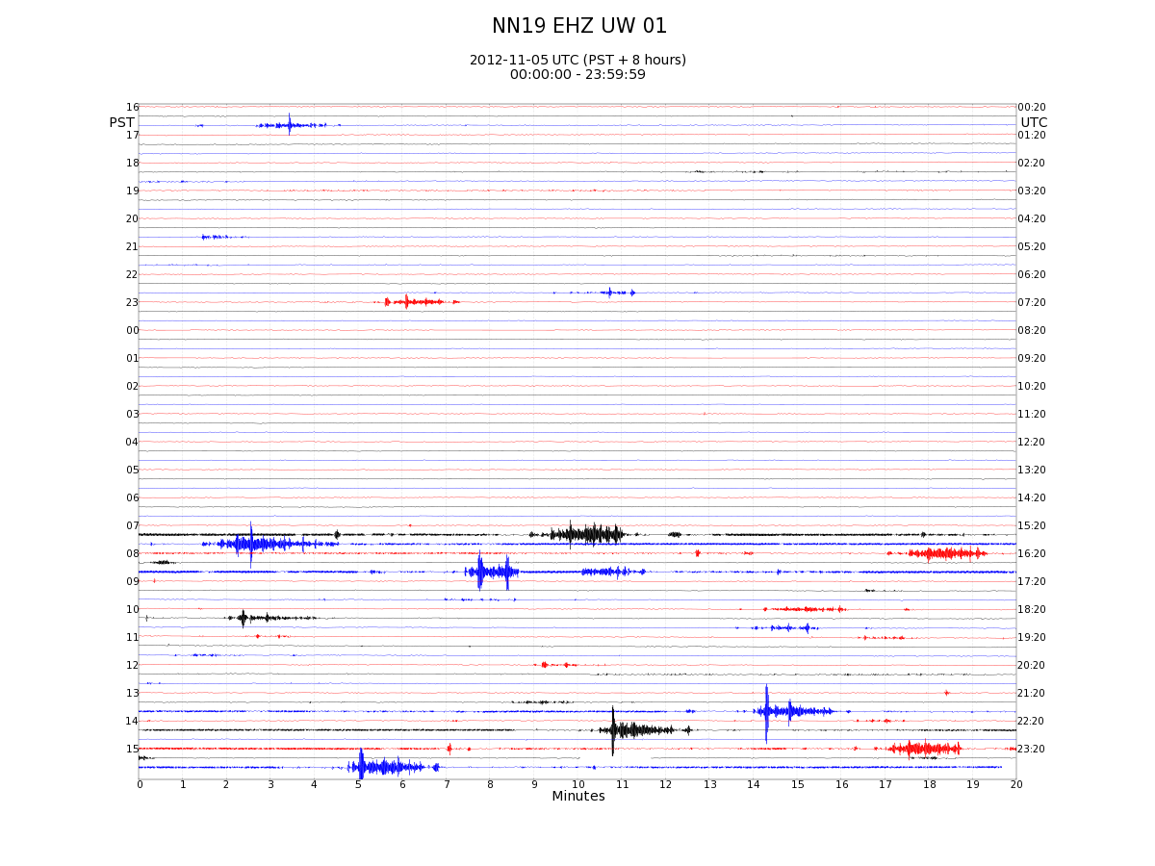
11/05/2012 (Mon): NN19 Z

Slide 14
11/05/2012: NN19 Z

Slide 15
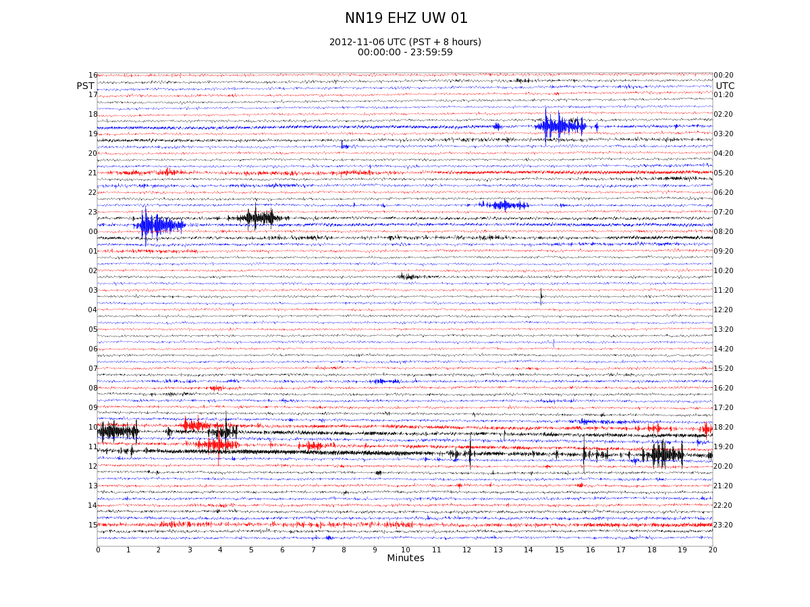
11/06/2012: NN19 Z

Slide 16
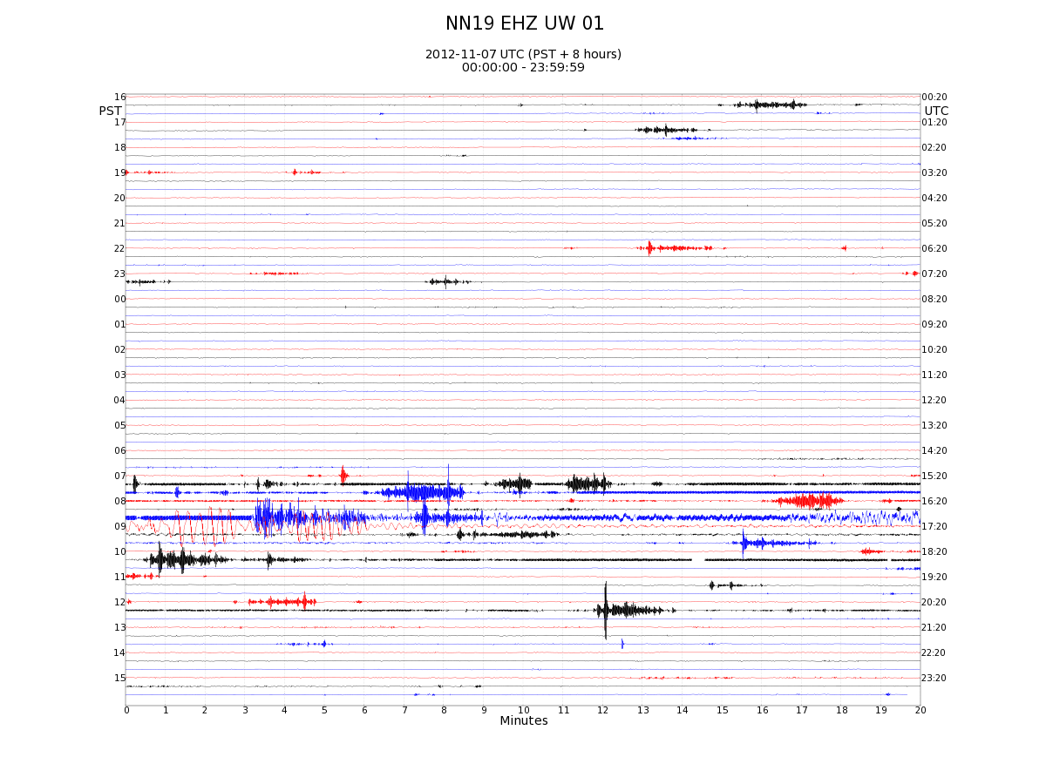
11/07/2012: NN19 Z M7.4 in Guatamala at 16:35 UTC

Slide 17
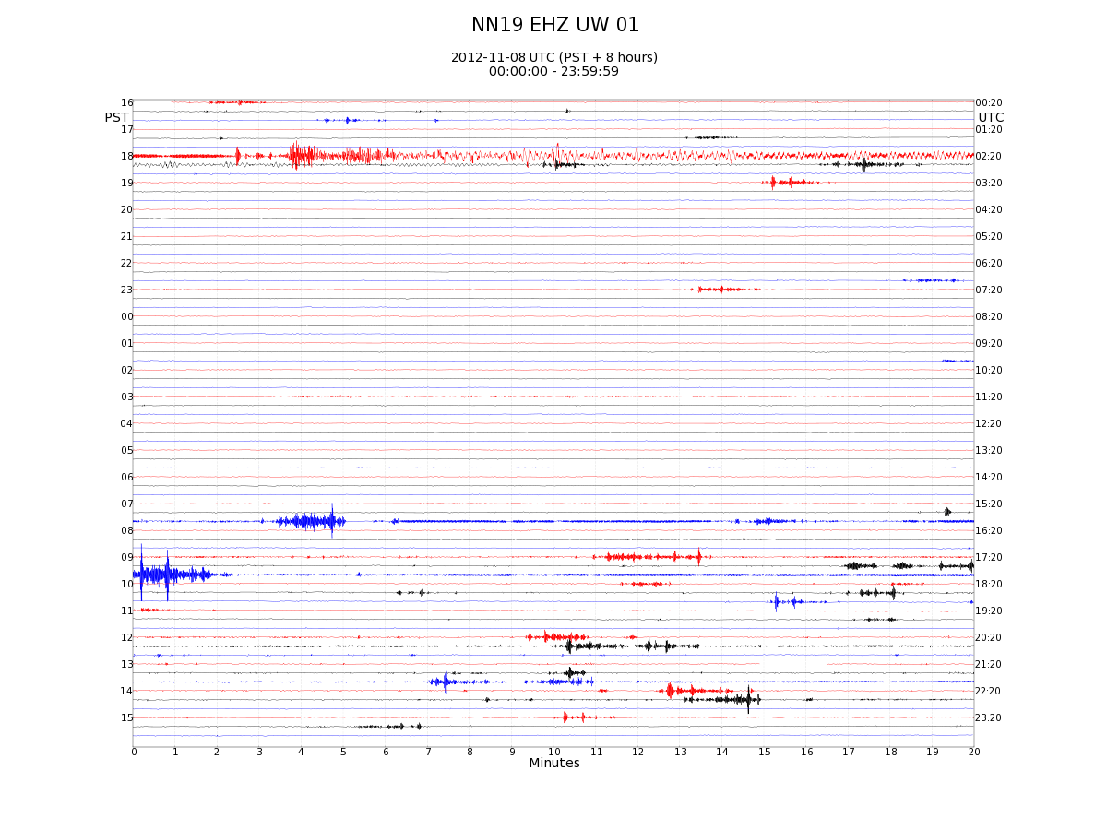
11/08/2012 (Thurs): NN19 Z

Slide 18
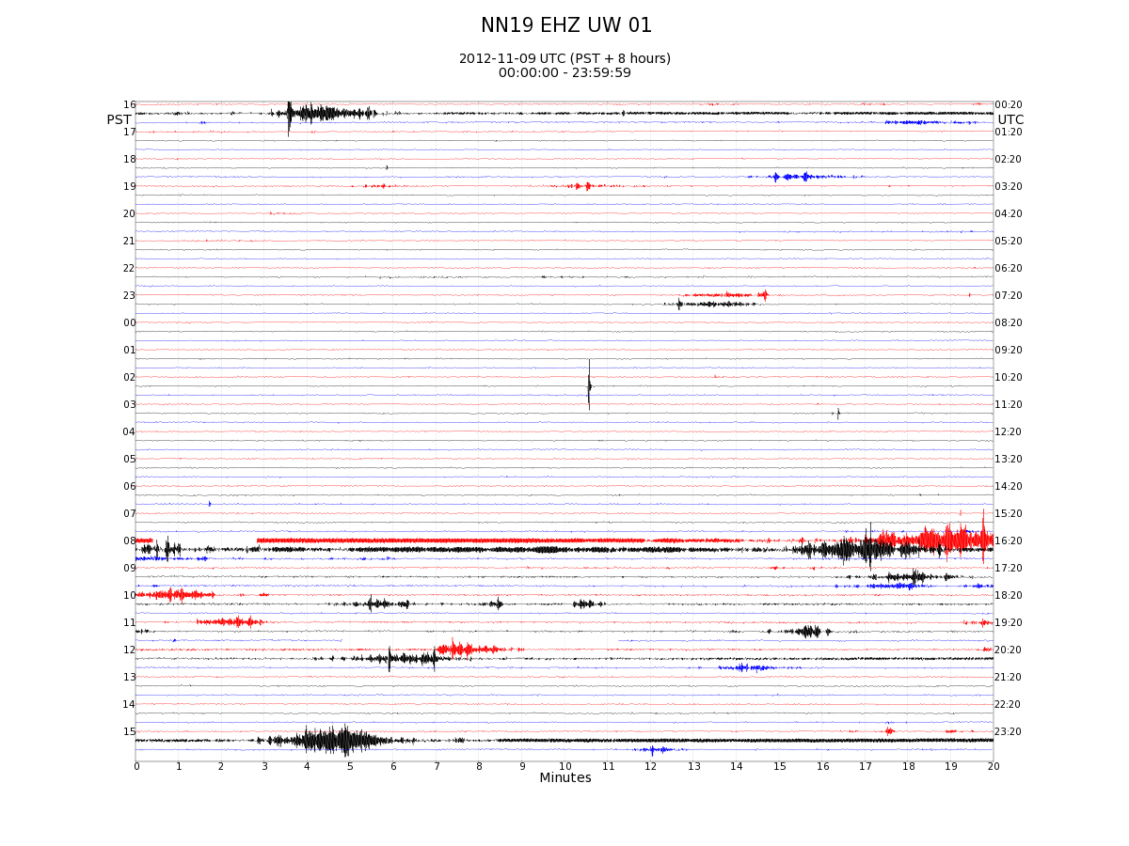
11/09/2012 (Fri): NN19 Z last day of operations at Finley Butte Quarry?

Slide 19
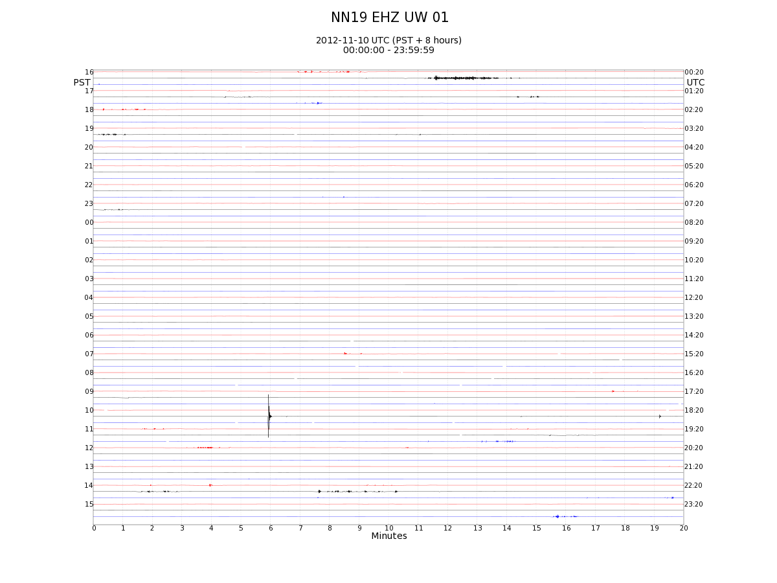
11/10/2012 (Sat): NN19 Z

Slide 20
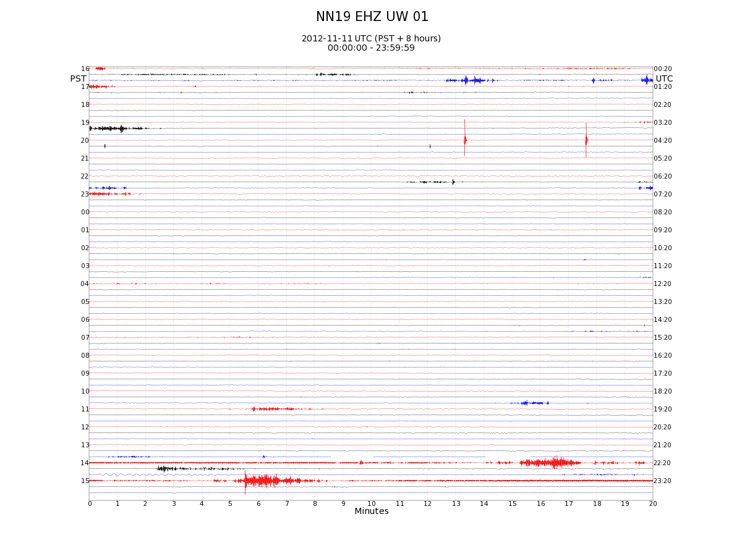
11/11/2012: NN19 Z M6.5 in Gutamala, 22:15 UTC

Slide 21
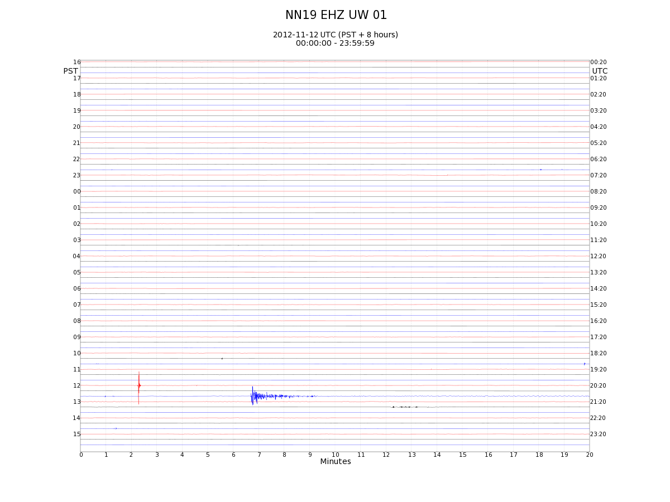
11/12/2012 (Mon): NN19 Z M6.5 in Gulf of Alaska

Slide 22
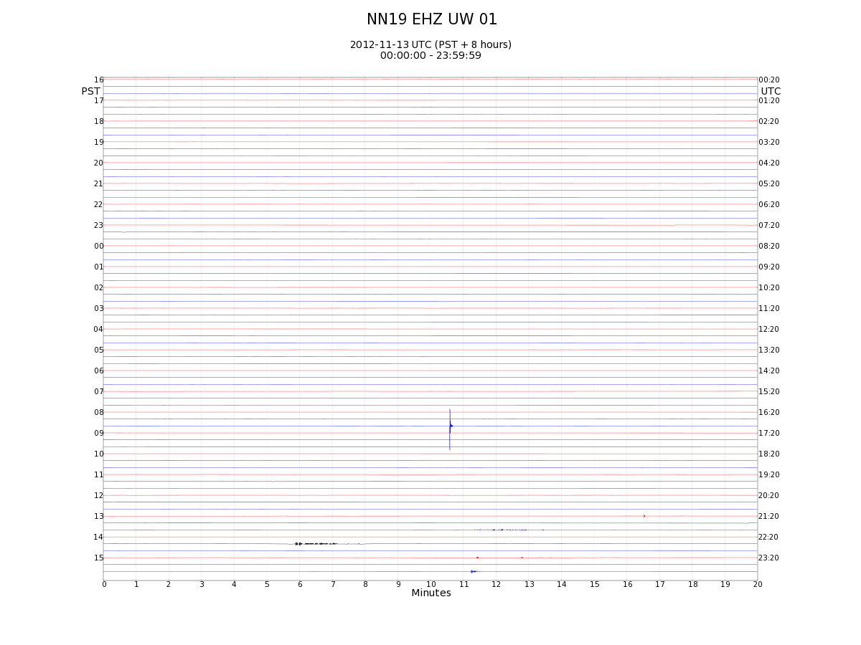
11/13/2012: NN19 Z

Slide 23
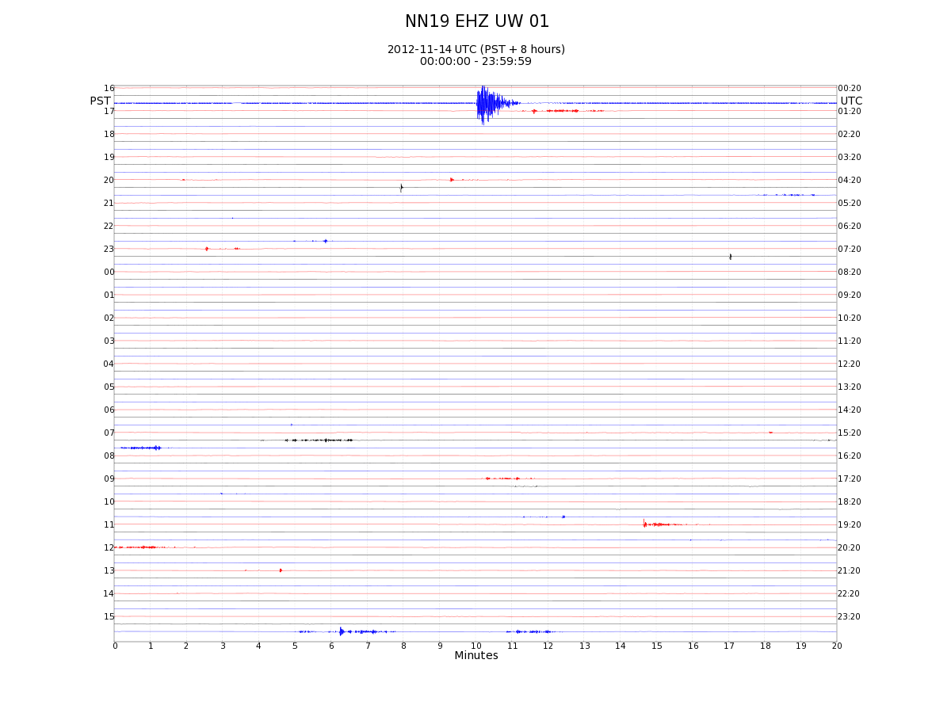
11/14/2012: NN19 Z

Slide 24
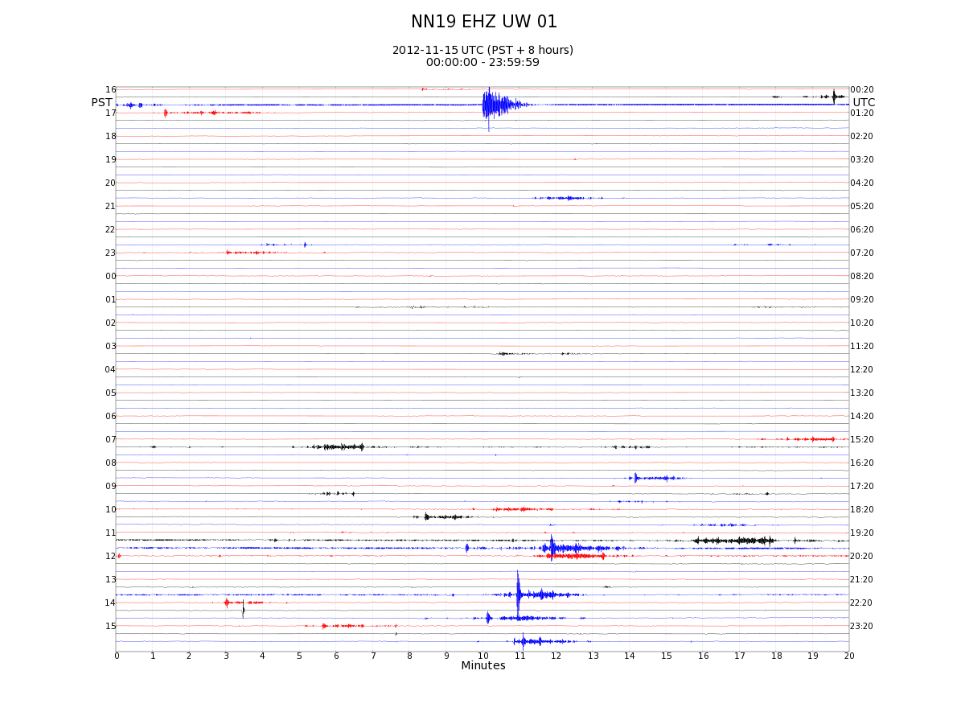
11/15/2012: NN19 Z

Slide 25
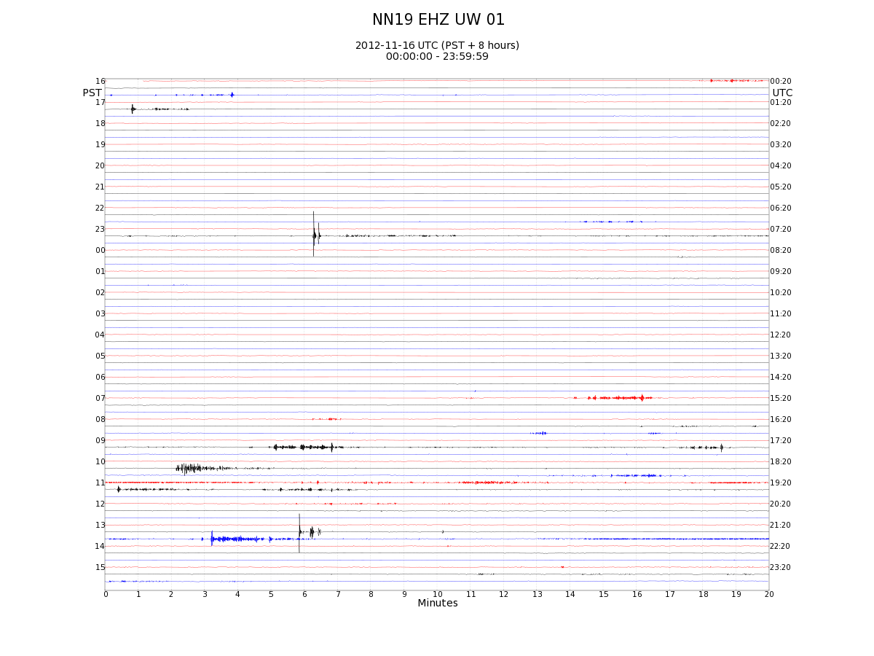
11/16/2012: NN19 Z

Slide 26
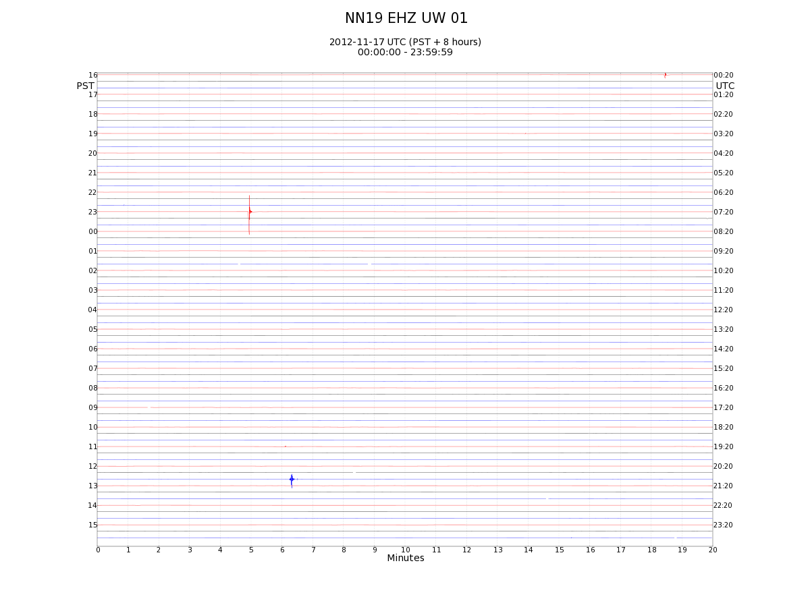
11/17/2012: NN19 Z

Slide 27
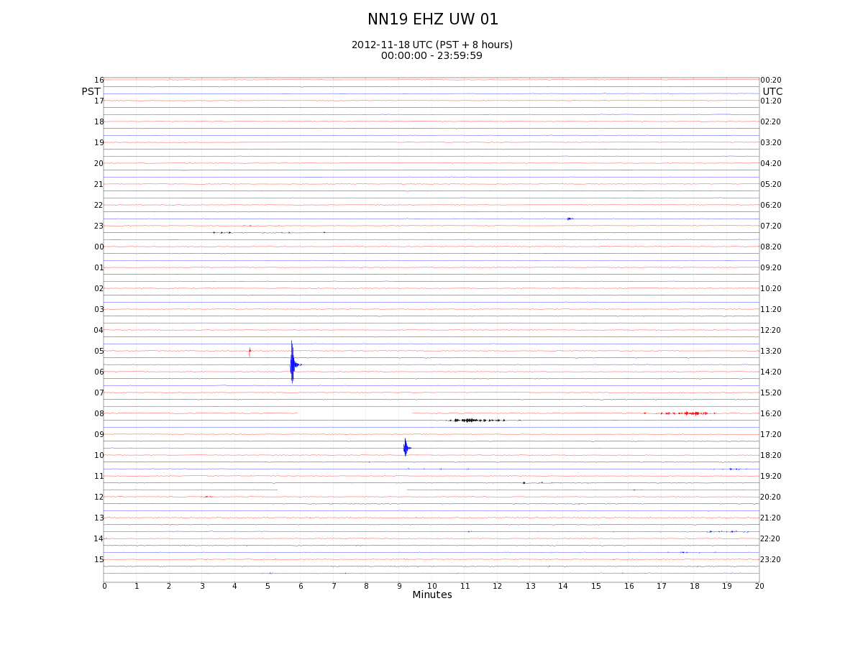
11/18/2012: NN19 Z

Slide 28
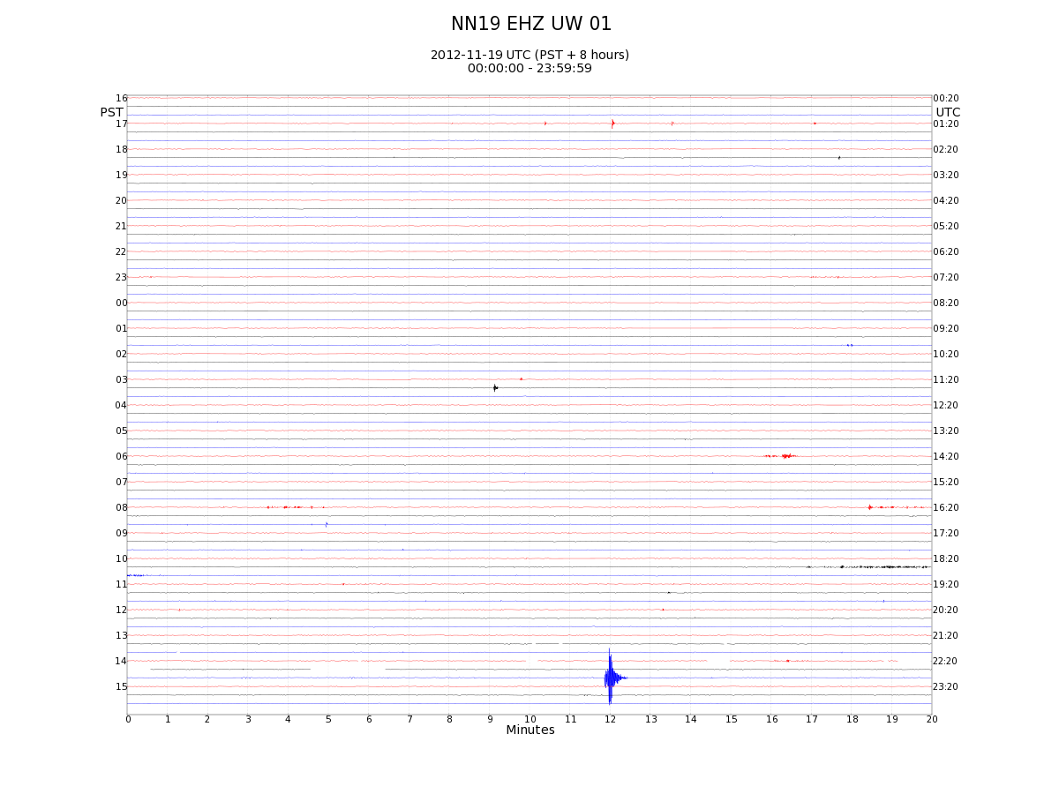
11/19/2012: NN19 Z

Slide 29
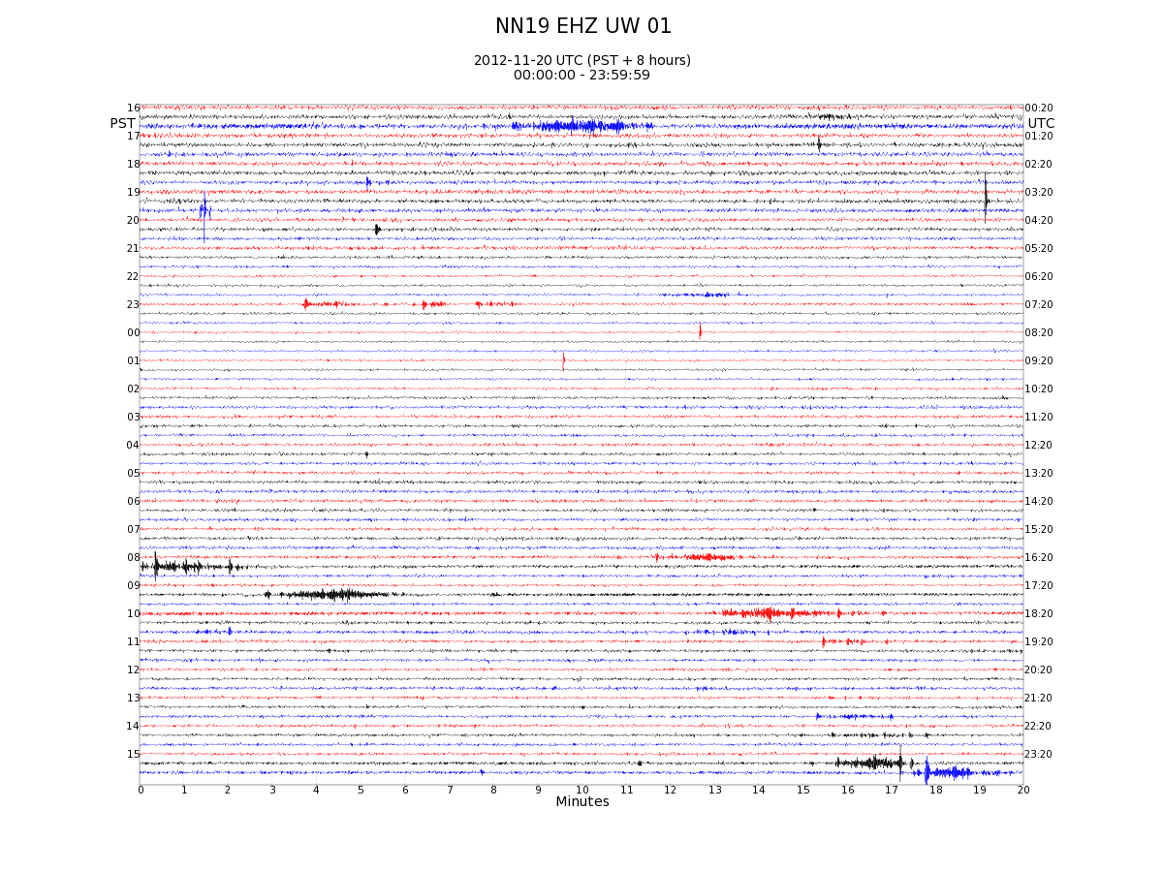
11/20/2012: NN19 Z

Slide 30
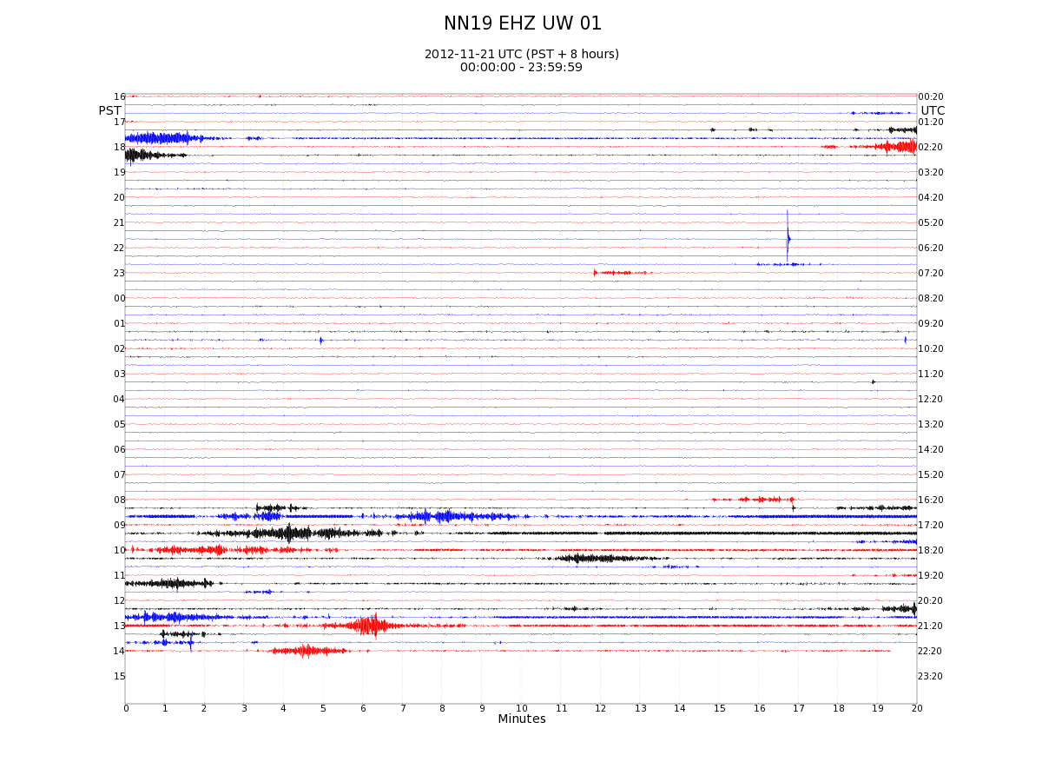
11/22/2012: NN19 Z

Slide 31
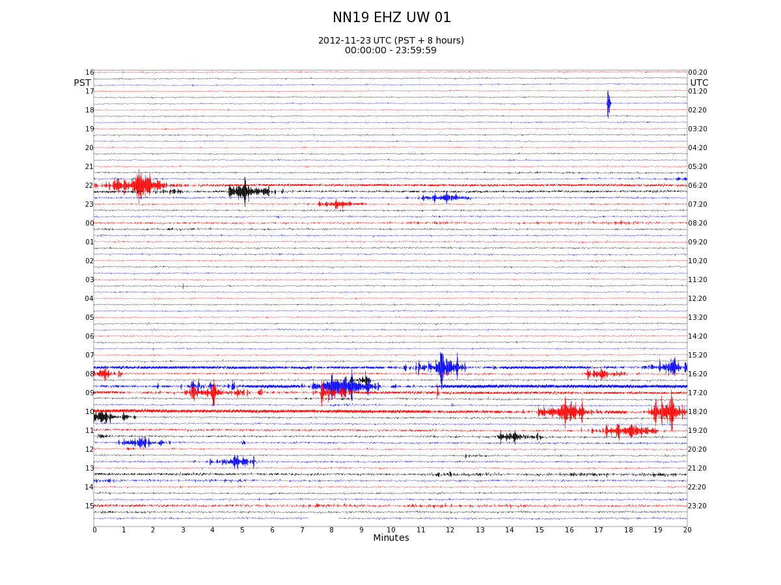
11/23/2012: NN19 Z

Slide 32
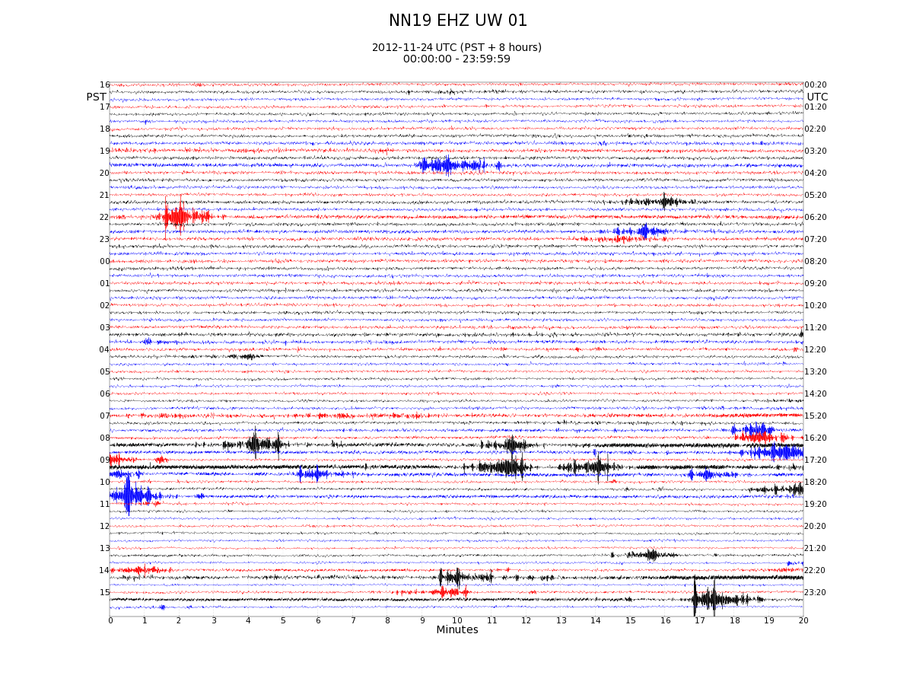
11/24/2012: NN19 Z

Slide 33
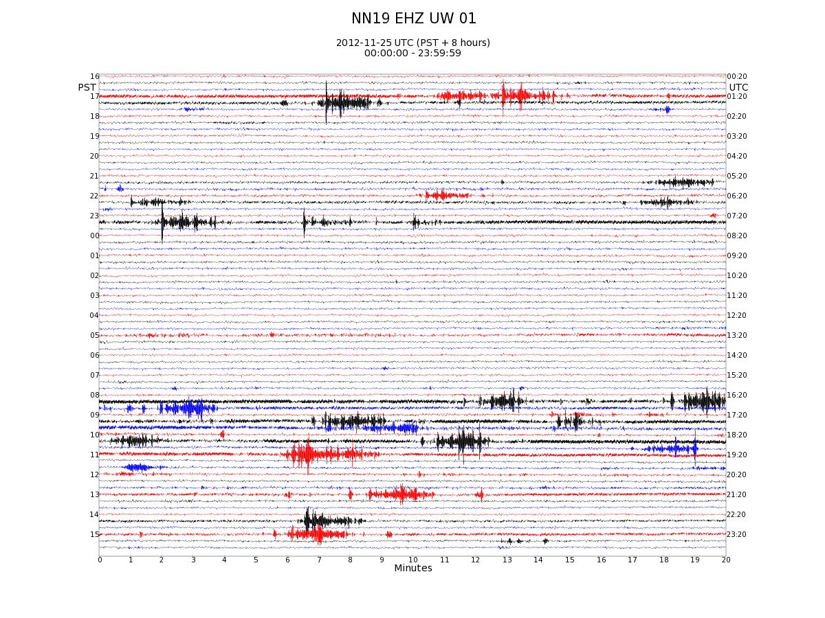
11/25/2012: NN19 Z

Slide 34
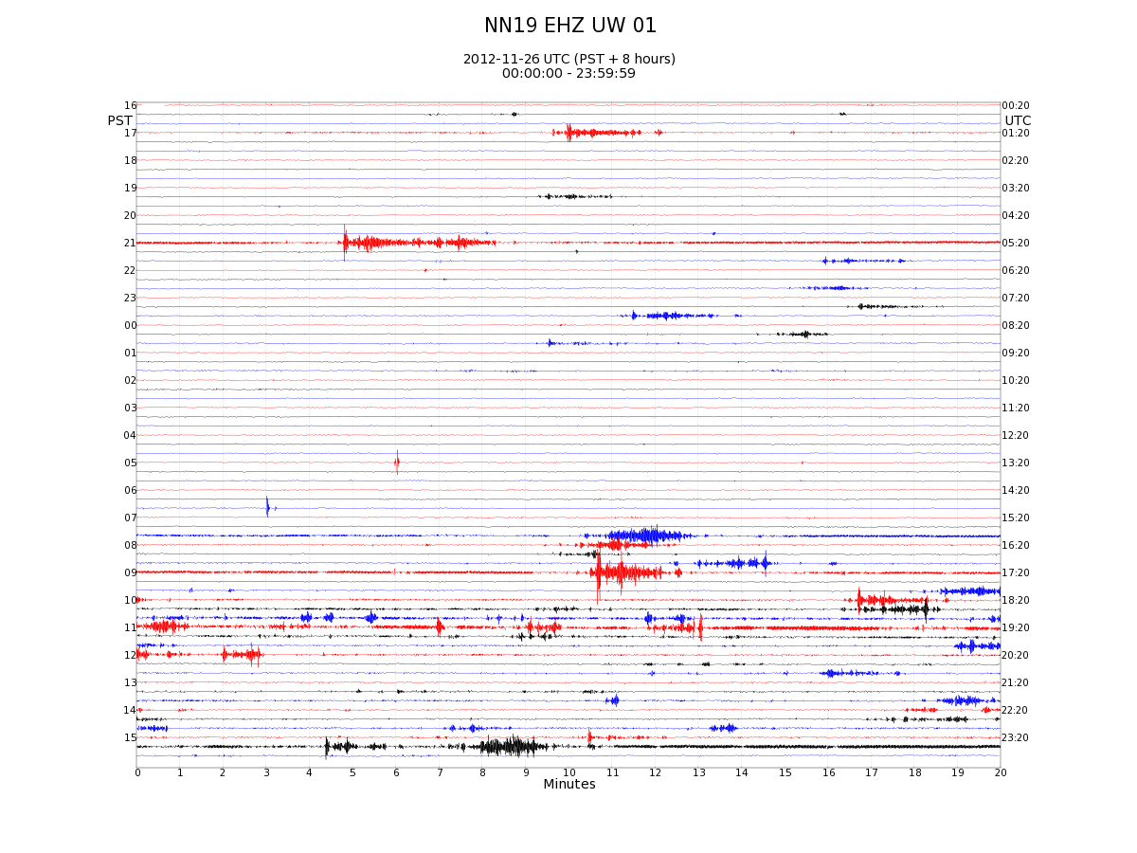
11/26/2012: NN19 Z

Slide 35
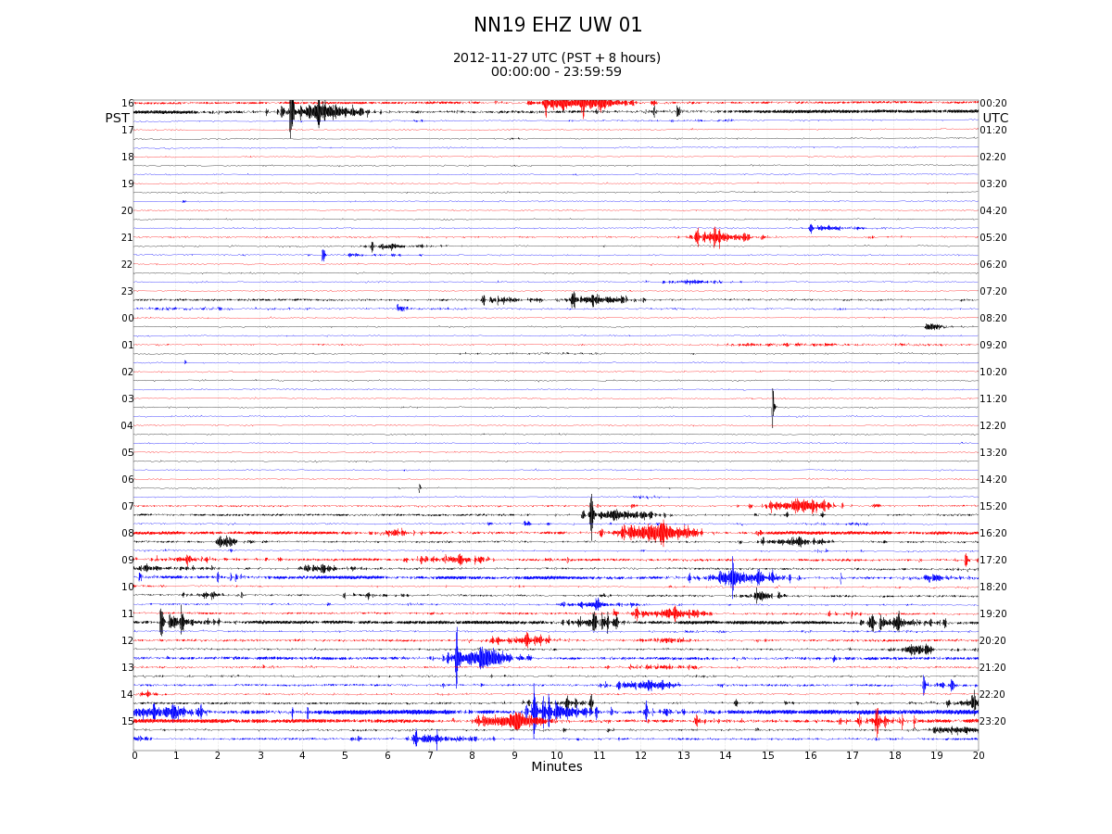
11/27/2012: NN19 Z

Slide 36
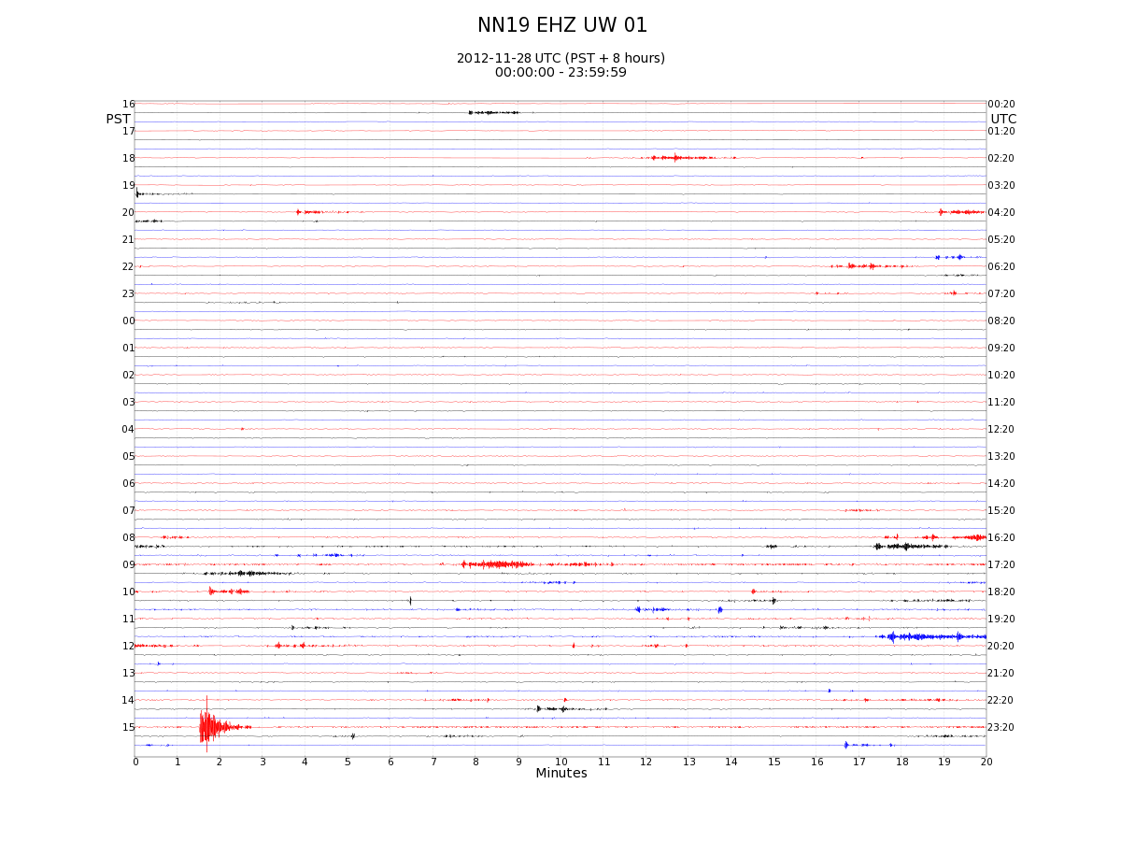

Slide 37
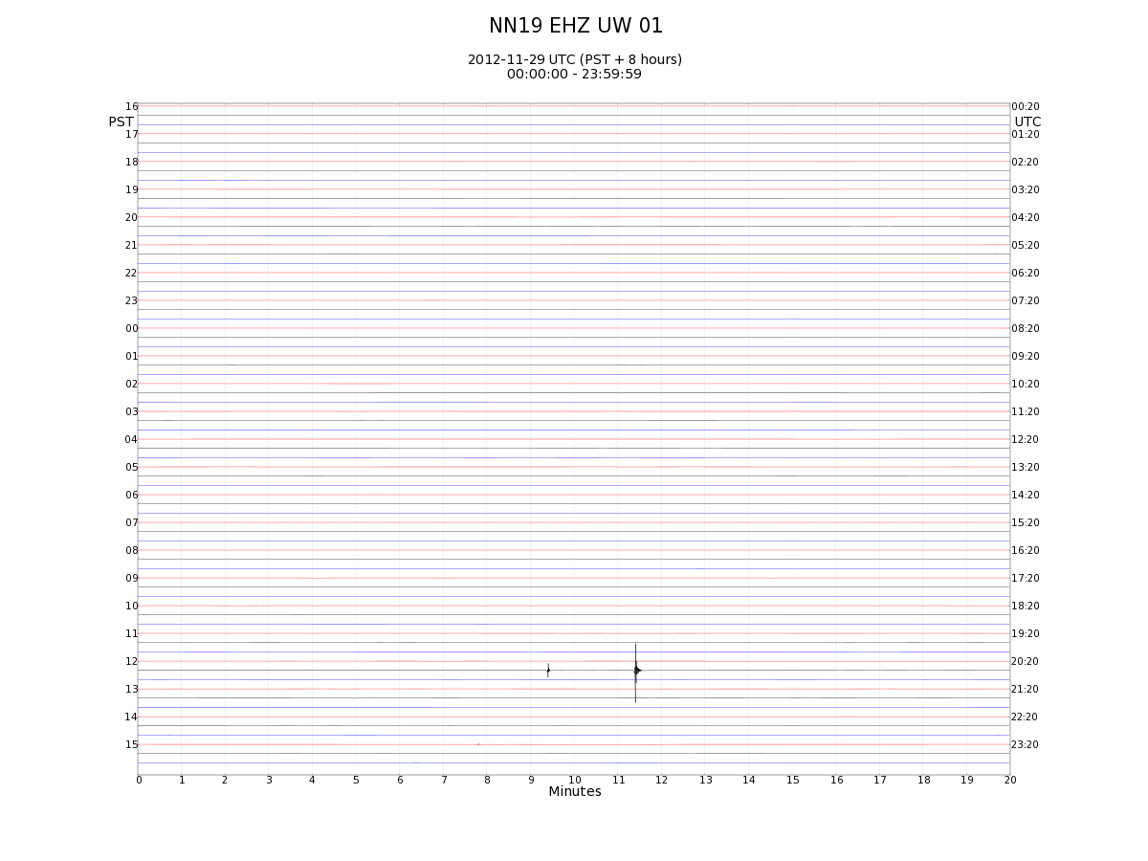

Slide 38
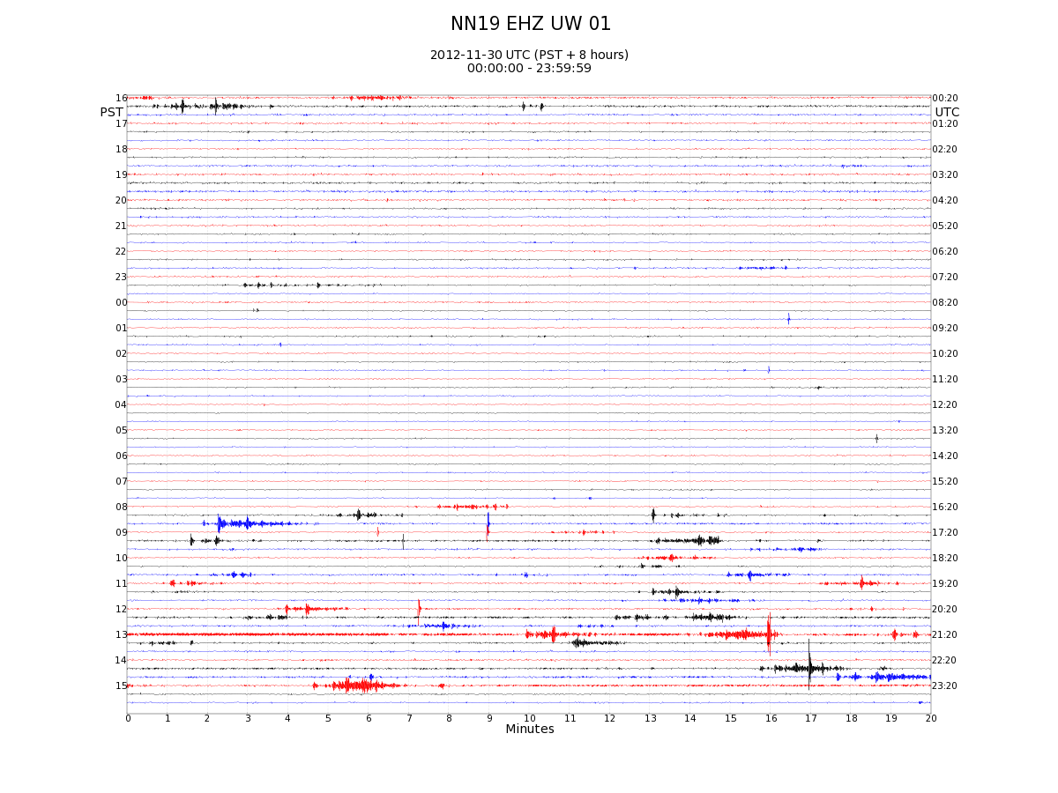

Slide 39
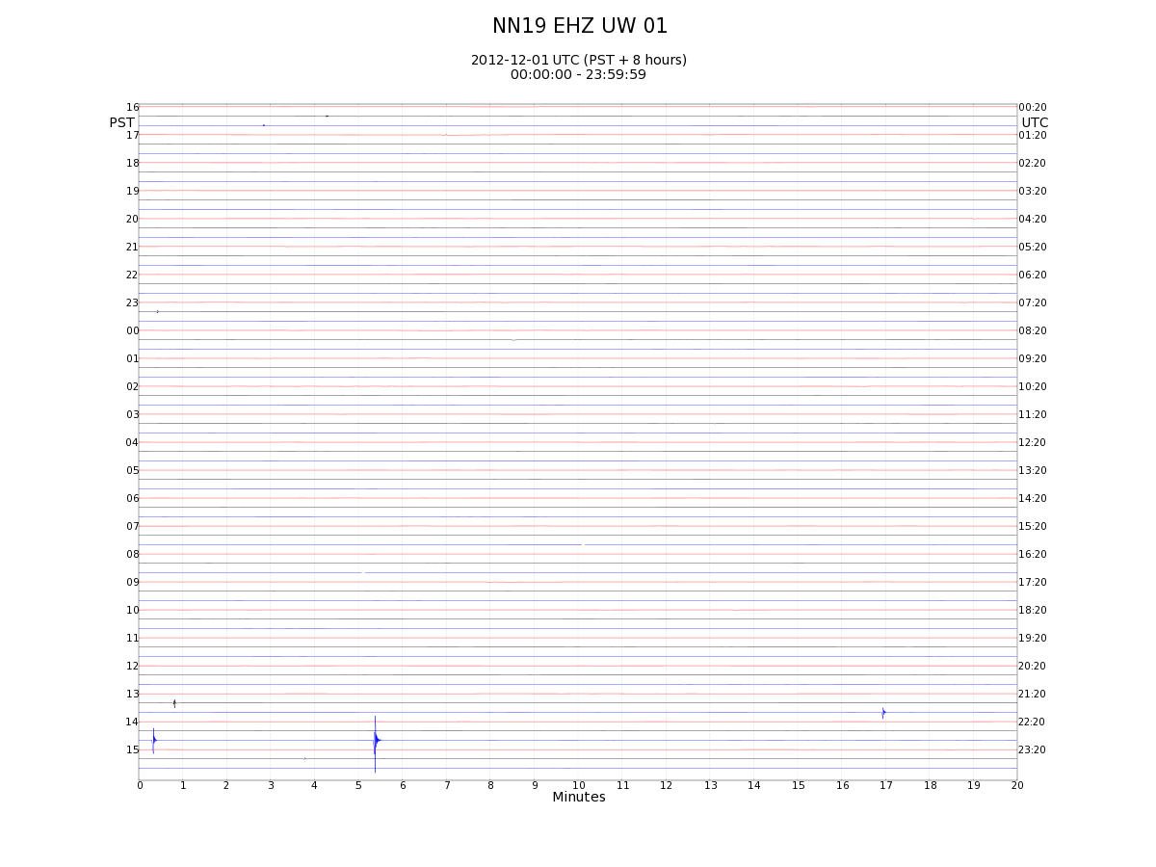

Slide 40
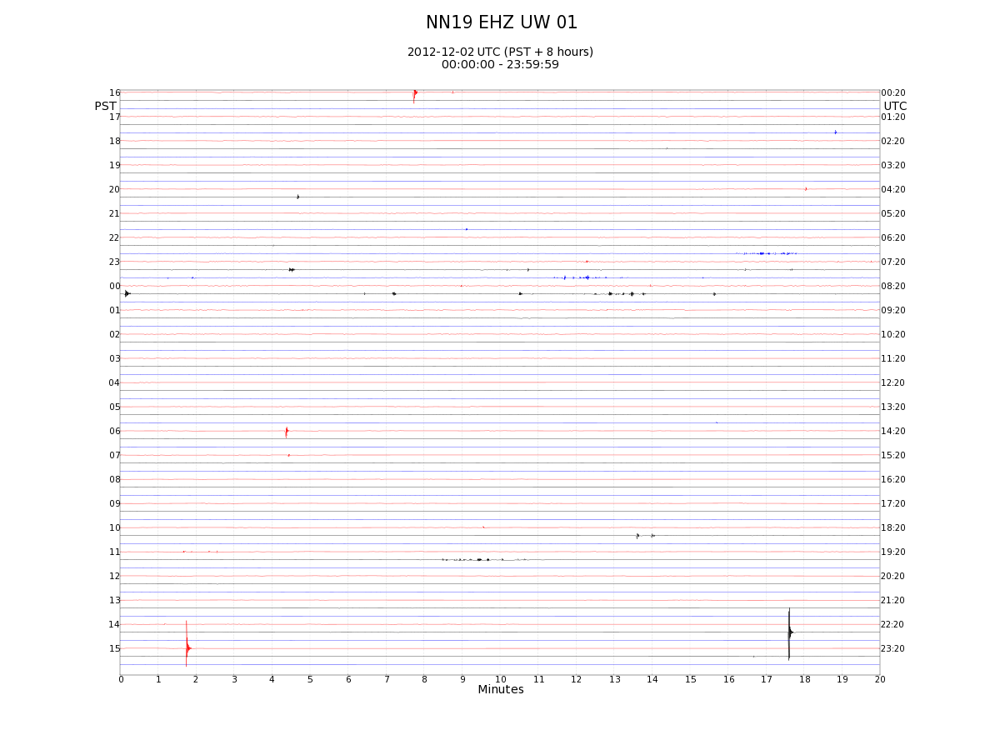

Slide 41
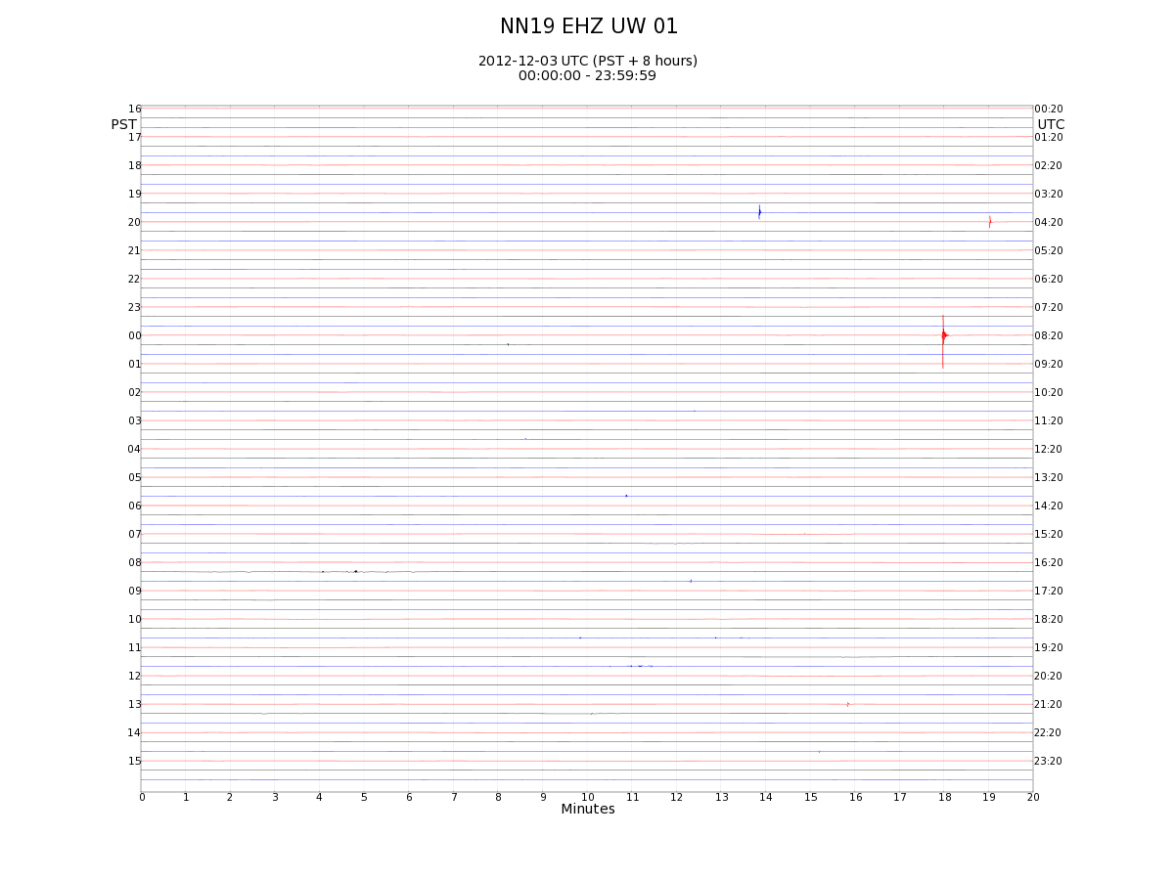

Slide 42
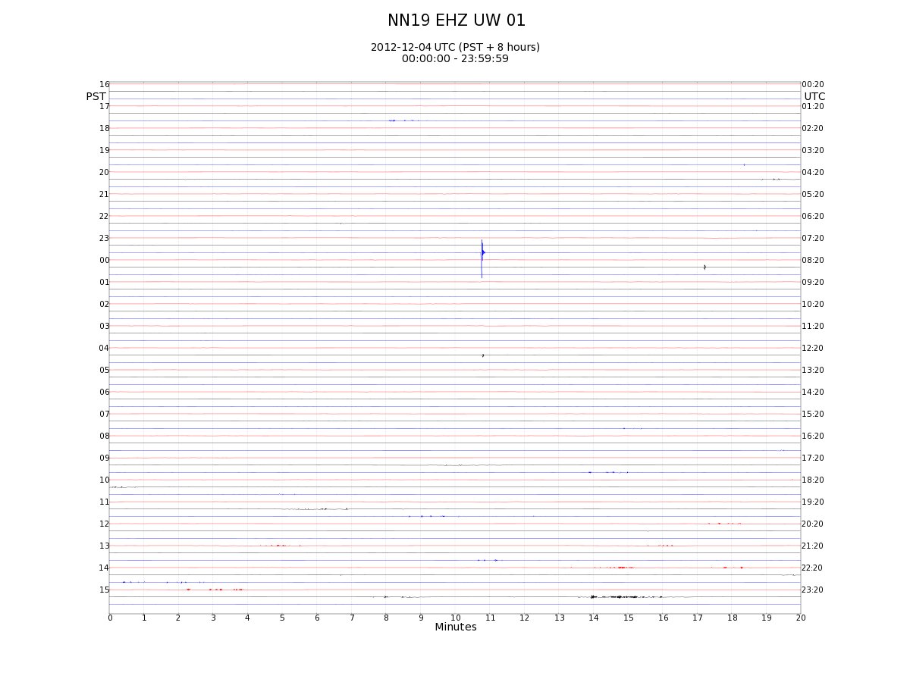

Slide 43
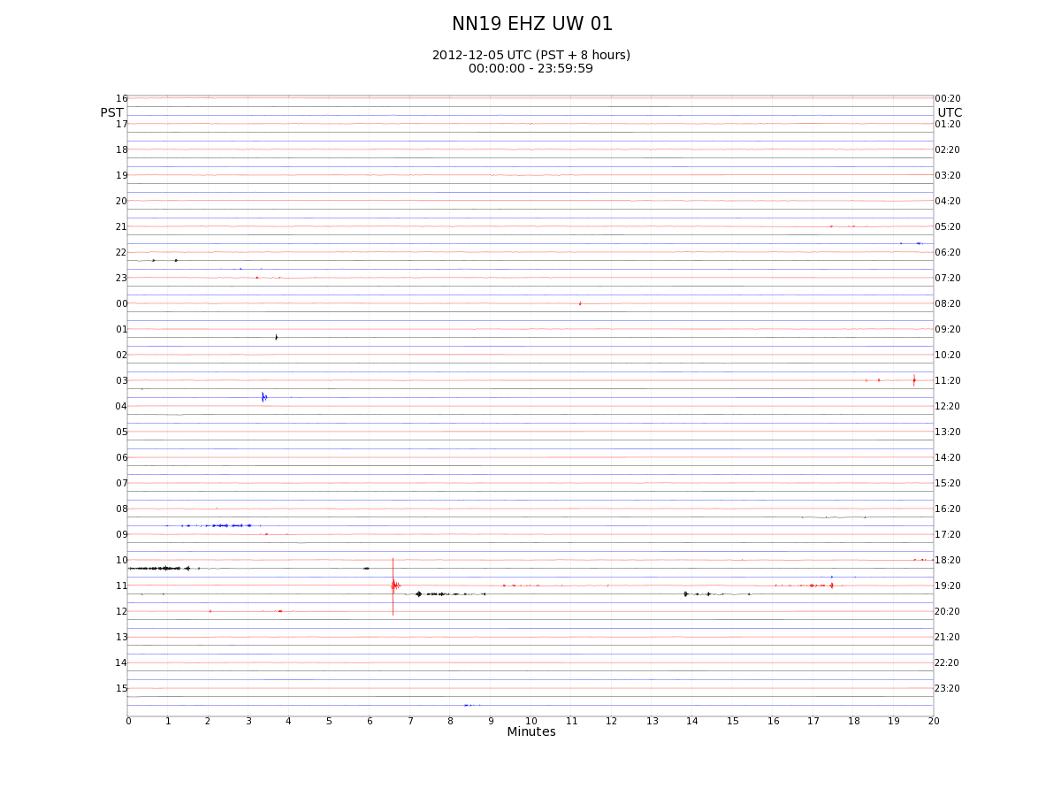

Slide 44
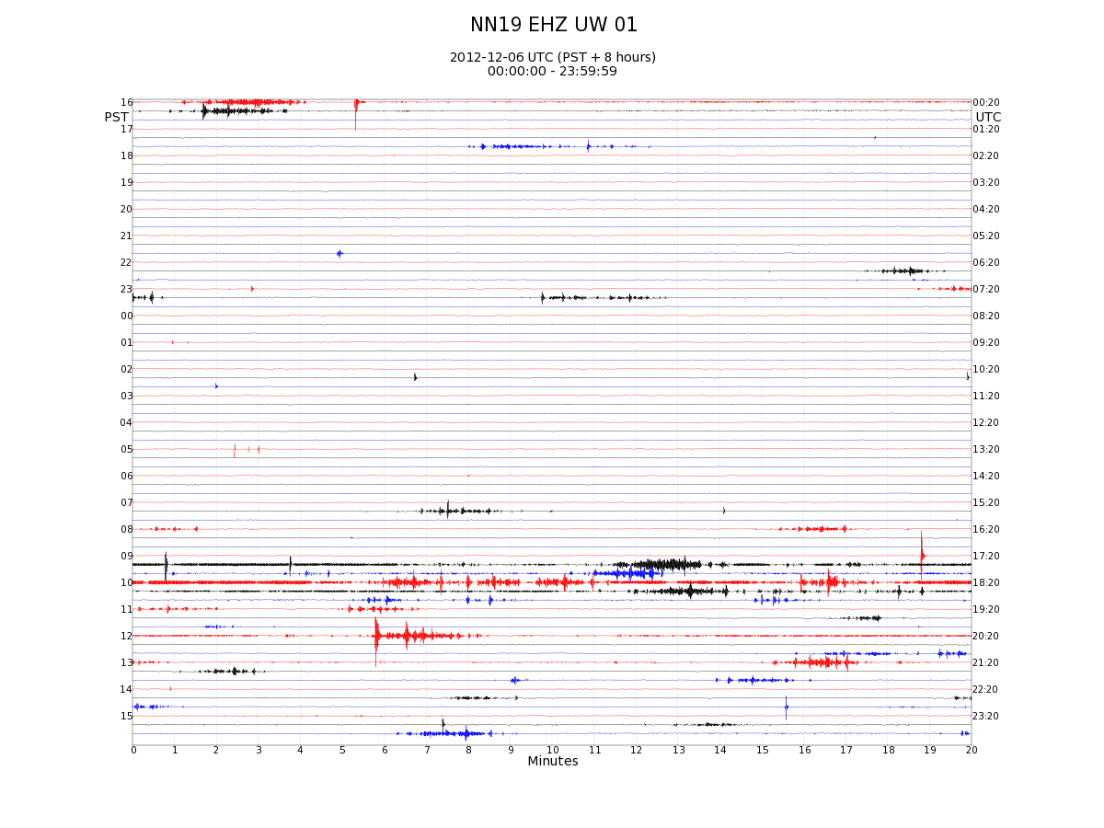

Slide 45
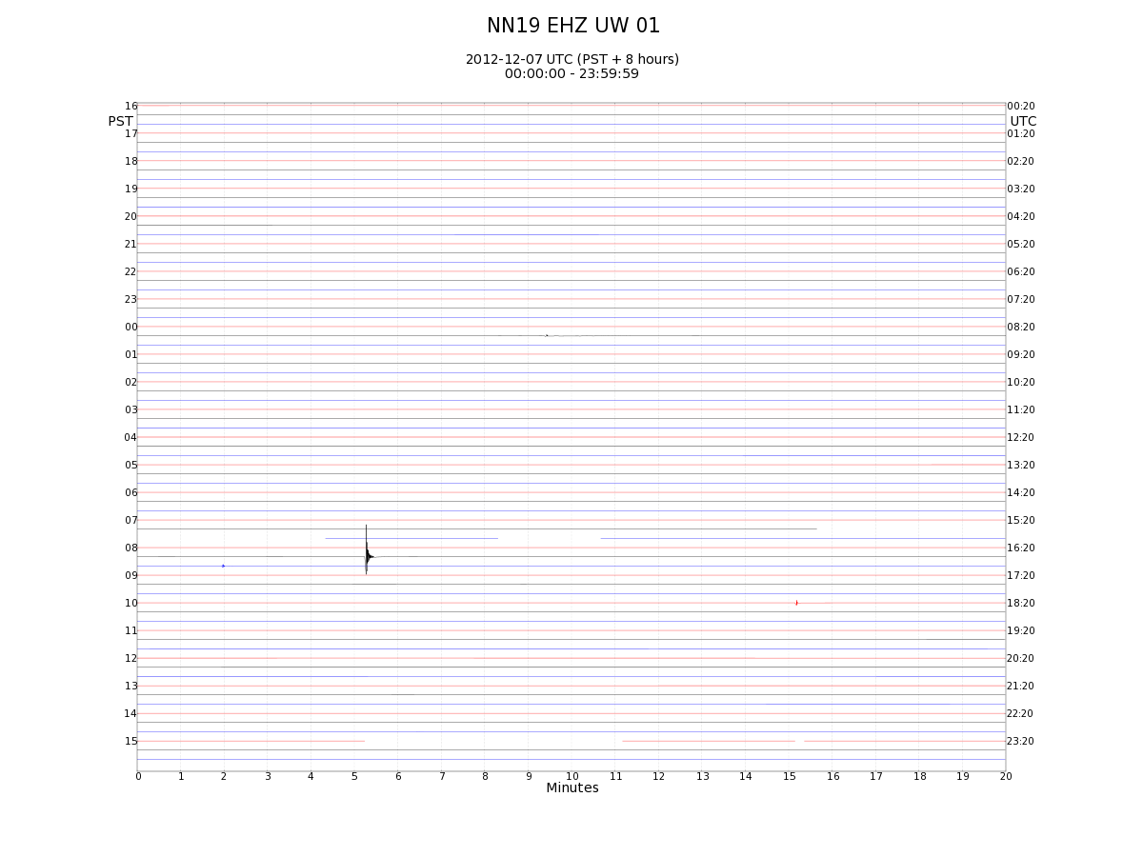

Slide 46
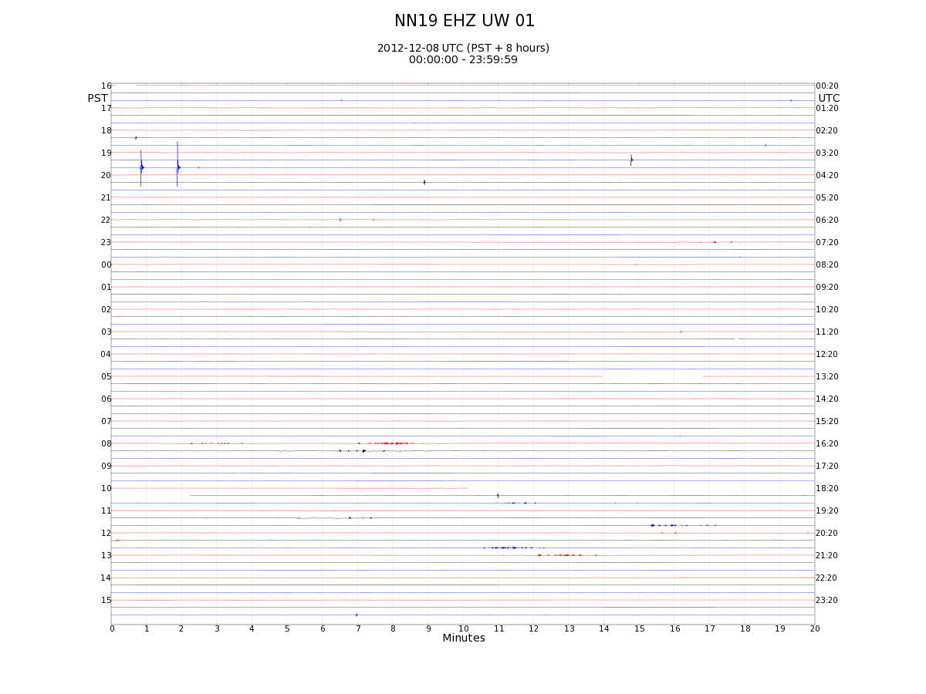

Slide 47
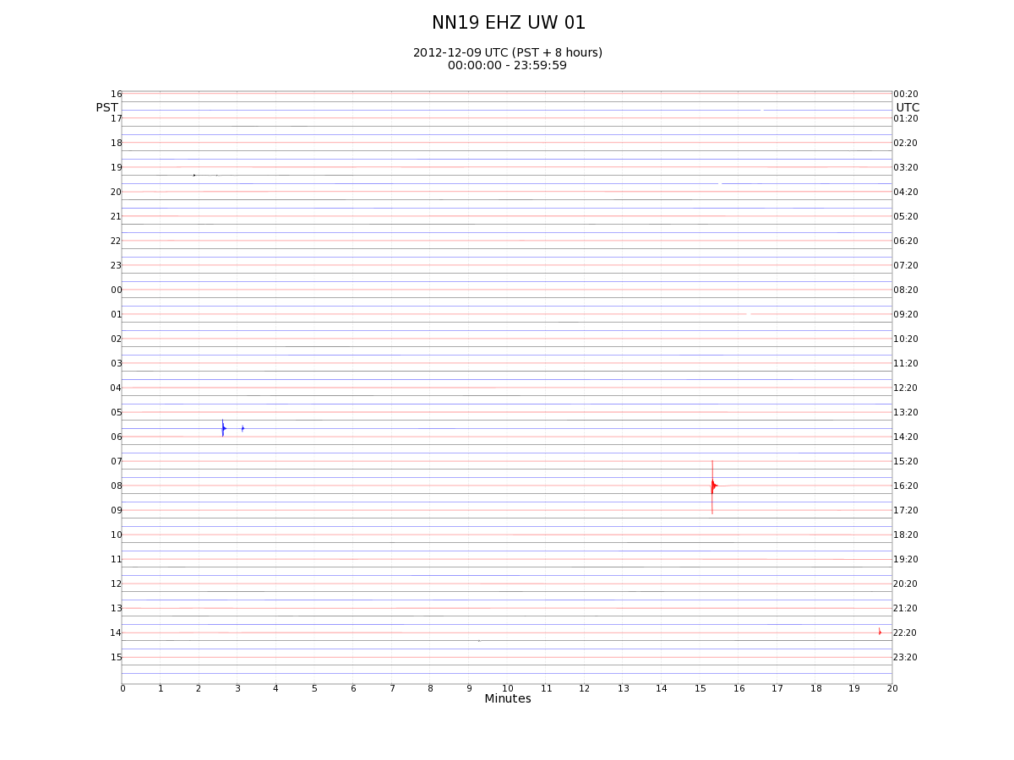

Slide 48
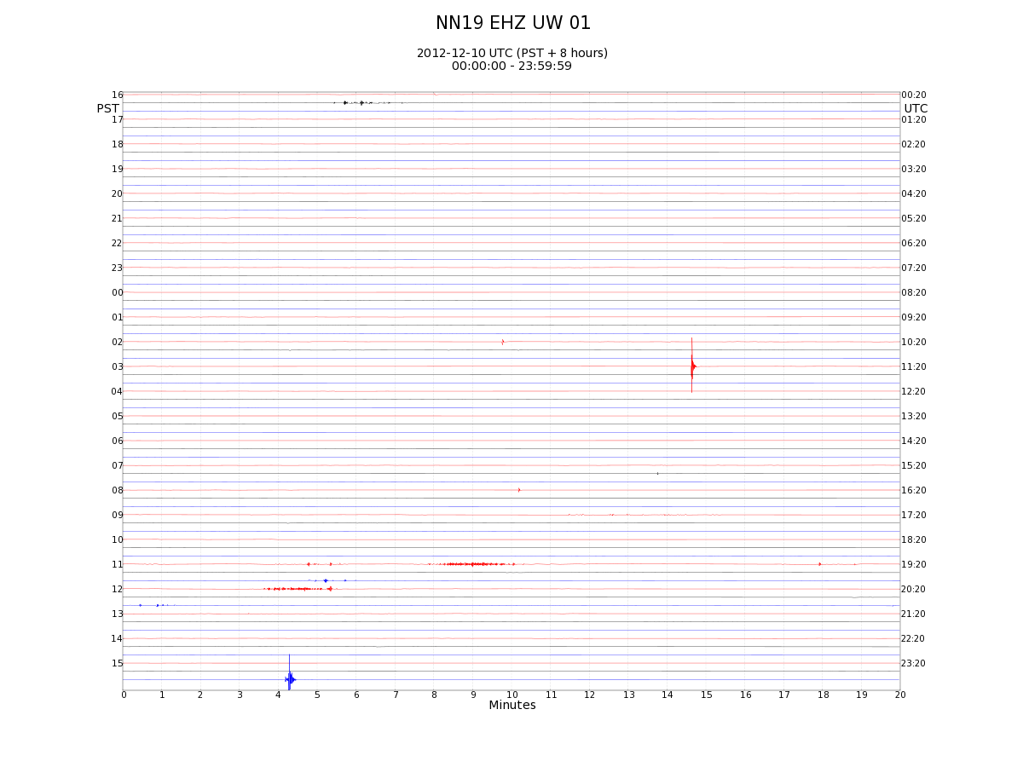

Slide 49
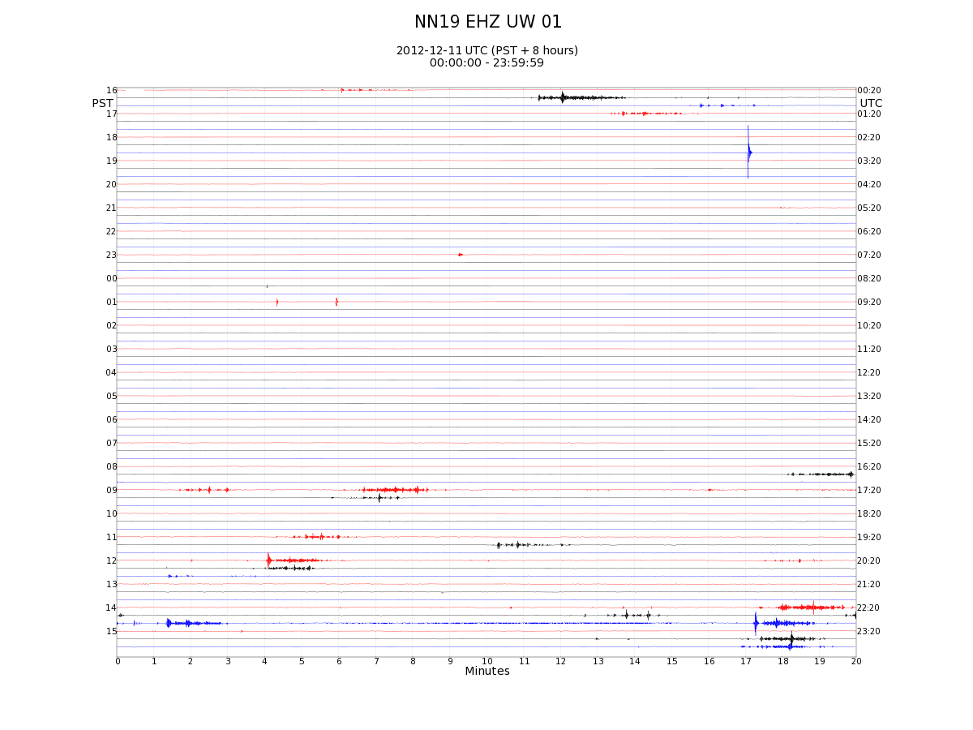

Slide 50
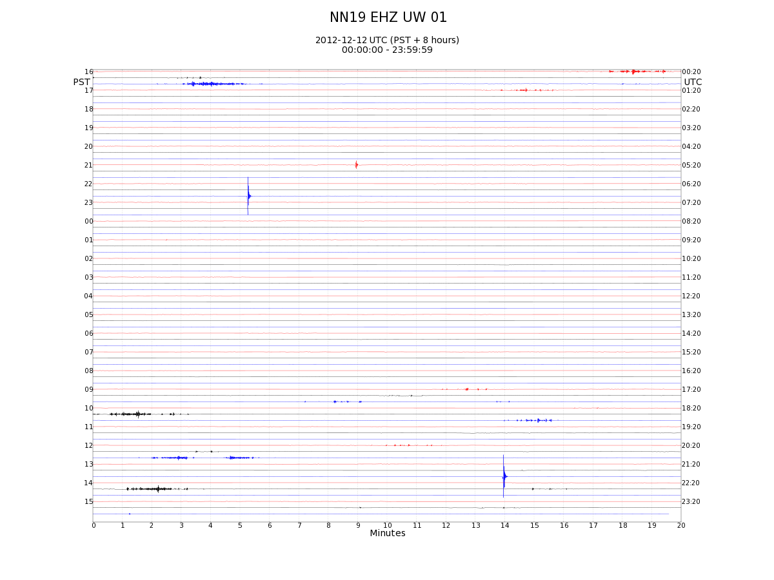

Slide 51
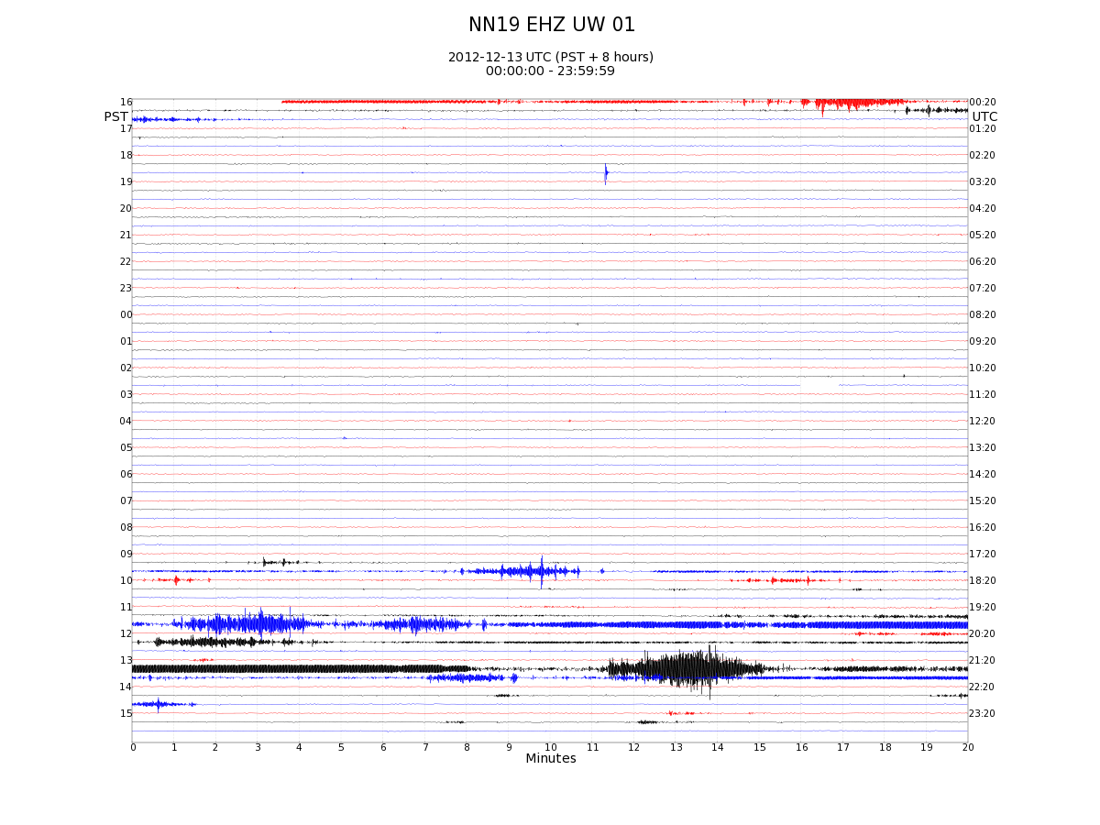

Slide 52


Slide 53


Slide 54


Slide 55


Slide 56


Slide 57


Slide 58


Slide 59


Slide 60


Slide 61


Slide 62


Slide 63


Slide 64


Slide 65


Slide 66


Slide 67


Slide 68


Slide 69


Slide 70


Slide 71


Slide 72


Slide 75


Slide 76

M 7.5 – 94 km W of Craig, Alaska 2013-01-05 08:58:19 UTC

Slide 77


Slide 78


Slide 79


Slide 80


Slide 81


Slide 82


Slide 83


Slide 84


Slide 85


Slide 86


Slide 87


Slide 88


